Slide 1
MAGMA: A Breakthrough in Solvers
for Eigenvalue Problems
Stan Tomov w/ J. Dongarra, A. Haidar, I. Yamazaki, T. Dong
T. Schulthess (ETH), and R. Solca (ETH)
University of Tennessee

Slide 2
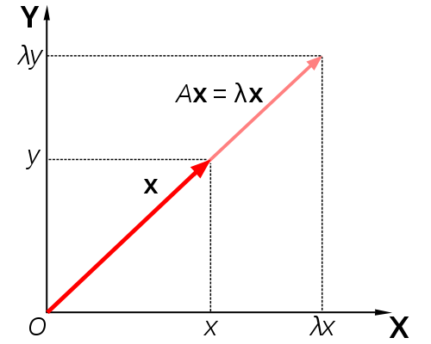
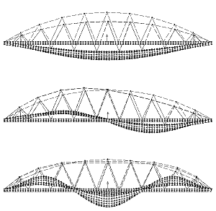
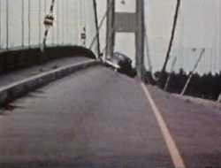
Eigenvalue and eigenvectors
A x = λ x
Quantum mechanics (Schrödinger equation)
Quantum chemistry
Principal component analysis (in data mining)
Vibration analysis (of mechanical structures)
Image processing, compression, face recognition
Eigenvalues of graph, e.g., in Google’s page rank
. . .
To solve it fast
[ acceleration analogy – car @ 64 mph vs speed of sound ! ]
T. Dong, J. Dongarra, S. Tomov, I. Yamazaki, T. Schulthess, and R. Solca, Symmetric dense matrix-vector multiplication on multiple GPUs and its application to symmetric dense and sparse eigenvalue problems, ICL Technical report, 03/2012.
J. Dongarra, A. Haidar, T. Schulthess, R. Solca, and S. Tomov, A novel hybrid CPU- GPU generalized eigensolver for electronic structure calculations based on fine grained memory aware tasks, ICL Technical report, 03/2012.

Slide 3
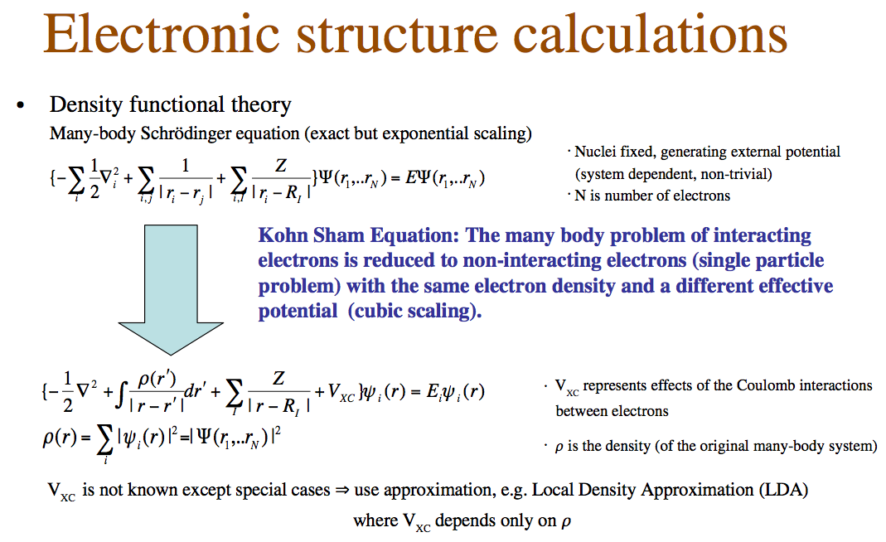
The need for eigensolvers
A model leading to self-consistent iteration computation with need for HP LA (e.g, diagonalization and orthogonalization)

Slide 4
The need for eigensolvers
Schodinger equation:
Hψ = Eψ
Choose a basis set of wave functions
Two cases:
  Orthonormal basis:
  H x = E x
  in general it needs a big basis set
  Non-orthonormal basis:
  H x = E S x

Slide 5
Hermitian Generalized Eigenproblem
Solve A x = λ B x
Compute the Cholesky factorization of B = LL^{H}
Transform the problem to a standard
eigenvalue problem Ã = L⁻¹AL^{−H}
Solve Hermitian standard Eigenvalue problem Ã y = λy
  Tridiagonalize Ã (50% of its flops are in Level 2 BLAS SYMV)
  Solve the tridiagonal eigenproblem
  Transform the eigenvectors of the tridiagonal to eigenvectors of Ã
Transform back the eigenvectors x = L^{−H} y

Slide 6
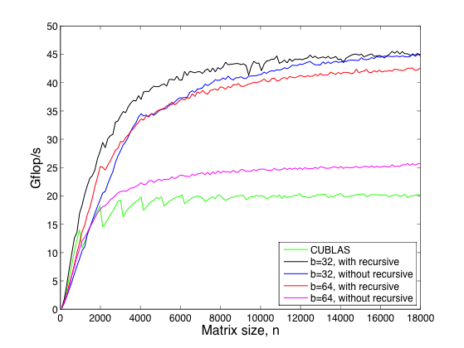
Fast BLAS development
Performance of MAGMA DSYMVs vs CUBLAS
Keeneland system, using one node
3 NVIDIA GPUs (M2090@ 1.55 GHz, 5.4 GB)
2 x 6 Intel Cores (X5660 @ 2.8 GHz, 23 GB)

Slide 7
Parallel SYMV on multiple GPUs
Multi-GPU algorithms were developed
  1-D block-cyclic distribution
  Every GPU
    has a copy of x
    Computes y_{i} = α A_{i} where A_{i} is the local
    for GPU i matrix
    Reuses the single GPU kernels
  The final result
  is computed on the CPU
GPU
0
GPU
1
GPU
2
GPU
0
...

Slide 8
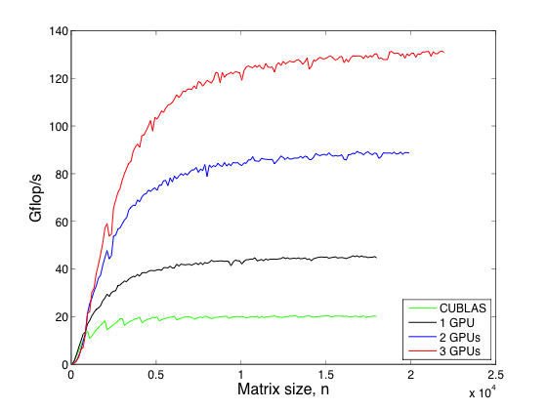
Parallel SYMV on multiple GPUs
Performance of MAGMA DSYMV on multi M2090 GPUs
Keeneland system, using one node
3 NVIDIA GPUs (M2090@ 1.55 GHz, 5.4 GB)
2 x 6 Intel Cores (X5660 @ 2.8 GHz, 23 GB)

Slide 9
Hybrid Algorithms
Two-sided factorizations (to bidiagonal, tridiagonal, and upper Hessenberg forms) for eigen- and singular-value problems
Hybridization
  Trailing matrix updates (Level 3 BLAS) are done on the GPU
  (similar to the one-sided factorizations)
  Panels (Level 2 BLAS) are hybrid
  – operations with memory footprint restricted to the panel are done on CPU
  – The time consuming matrix-vector products involving the entire trailing
  matrix are done on the GPU

Slide 10
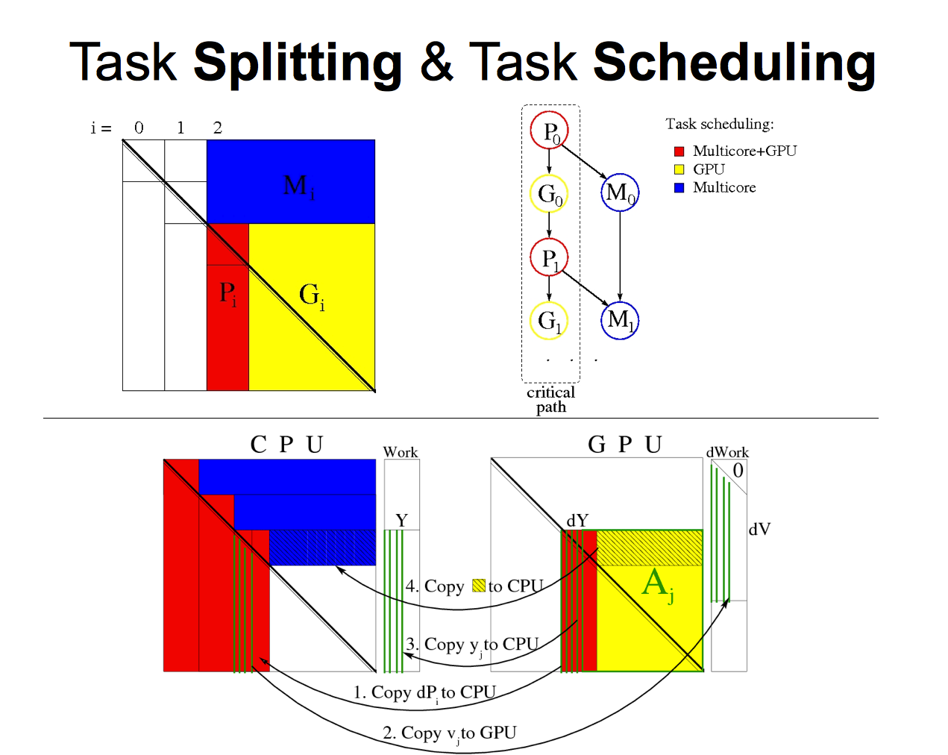
Hybrid Two-Sided Factorizations

Slide 11
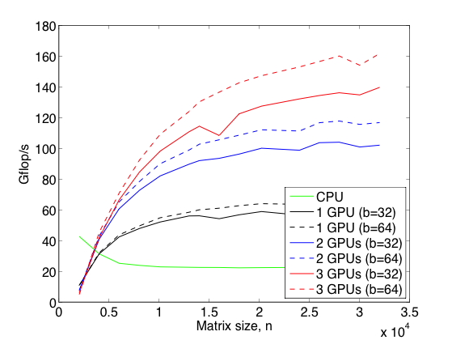
From fast BLAS to fast tridiagonalization
Performance of MAGMA DSYTRD on multi M2090 GPUs
50 % of the flops are in SYMV
Memory bound, i.e. does not scale well on multicore CPUs
Use the GPU’s high memory bandwidth and optimized SYMV
8 x speedup over 12 Intel cores
(X5660 @2.8 GHz)
Keeneland system, using one node
3 NVIDIA GPUs (M2090@ 1.55 GHz, 5.4 GB)
2 x 6 Intel Cores (X5660 @ 2.8 GHz, 23 GB)

Slide 12
Can we accelerate 4 x more ?
A two-stages approach
Increases the computational intensity by introducing
  1st stage: reduce the matrix to band
  [ Level 3 BLAS; implemented very efficiently on GPU using “look-ahead” ]
  2nd stage: reduce the band to tridiagonal
  [ memory bound, but we developed a very efficient “bulge” chasing
  algorithm with memory aware tasks for multicore to increase the
  computational intensity ]

Slide 13
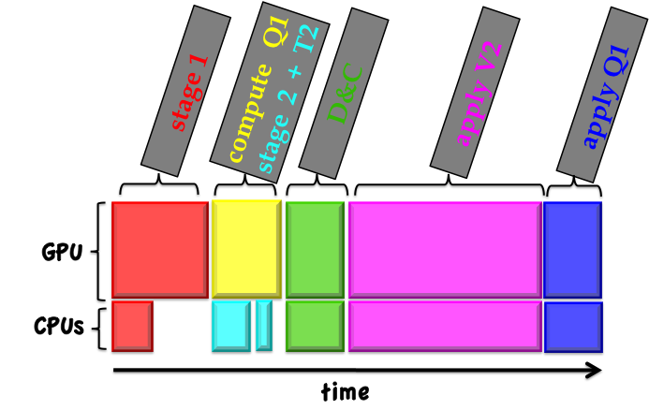
Schematic profiling of the eigensolver

Slide 14
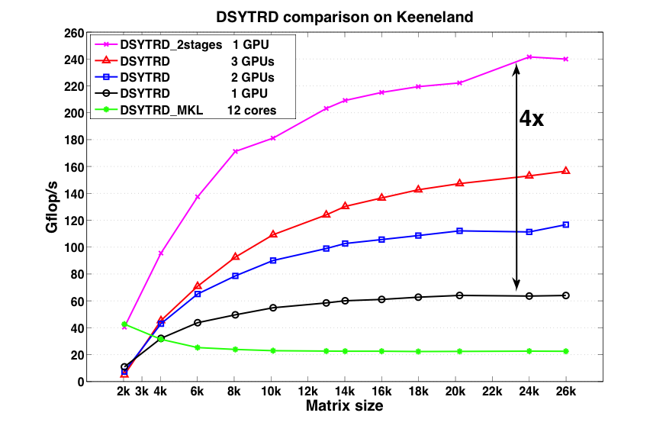
An additional 4 x speedup !
12 x speedup over 12 Intel cores
(X5660 @2.8 GHz)
Keeneland system, using one node
3 NVIDIA GPUs (M2090@ 1.55 GHz, 5.4 GB)
2 x 6 Intel Cores (X5660 @ 2.8 GHz, 23 GB)

Slide 15
Conclusions
Breakthrough eigensolver using GPUs
Number of fundamental numerical algorithms for GPUs
(BLAS and LAPACK type)
Released in MAGMA 1.2
Enormous impact in technical computing and applications
12 x speedup w/ a Fermi GPU vs state-of-the-art multicore system (12 Intel Core X5660 @2.8 GHz)
  From a speed of car to the speed of sound !

Slide 16




Colloborators / Support
MAGMA [Matrix Algebra on GPU
and Multicore Architectures] team
http://icl.cs.utk.edu/magma/
PLASMA [Parallel Linear Algebra
for Scalable Multicore
Architectures] team
http://icl.cs.utk.edu/plasma
Collaborating partners
University of Tennessee, Knoxville
University of California, Berkeley
University of Colorado, Denver
INRIA, France
KAUST, Saudi Arabia

