Slide 1
MAGMA – LAPACK for HPC on Heterogeneous Architectures
Stan Tomov and Jack Dongarra
Research Director
Innovative Computing Laboratory
Department of Computer Science
University of Tennessee, Knoxville
Titan Summit
Oak Ridge Leadership Computing Facility (OLCF)
Oak Ridge National Laboratory, TN
August 15, 2011

Slide 2
Outline
Motivation
MAGMA – LAPACK for GPUs
  Overview
  Methodology
  MAGMA with various schedulers
MAGMA BLAS
Current & future work directions

Slide 3
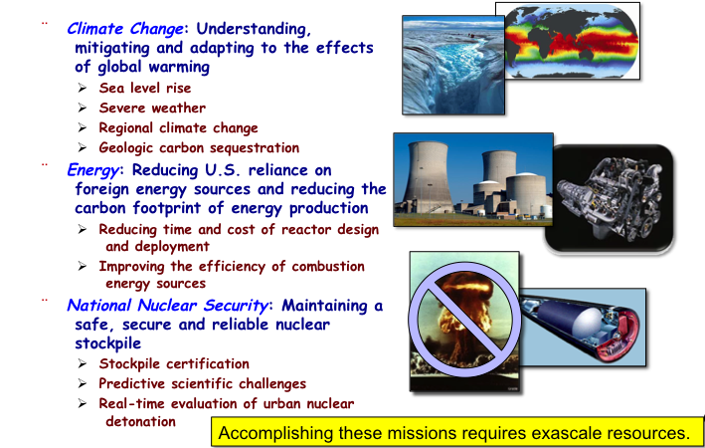
Science and Engineering Drivers

Slide 4
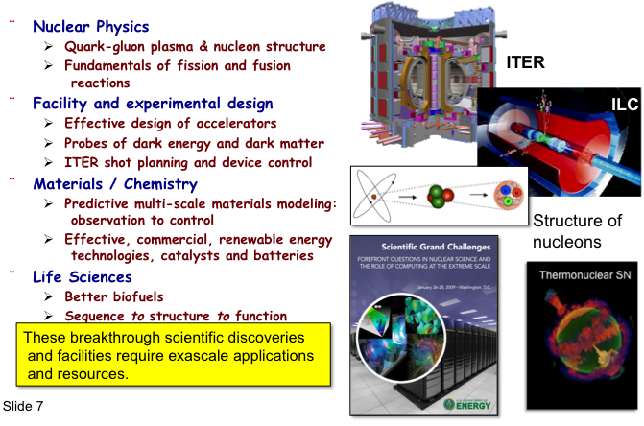
Simulation enables fundamental advances in basic science

Slide 5
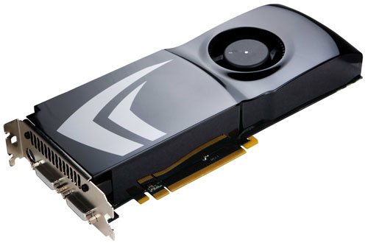
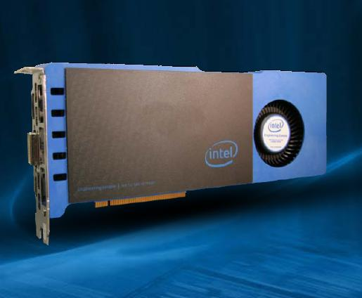


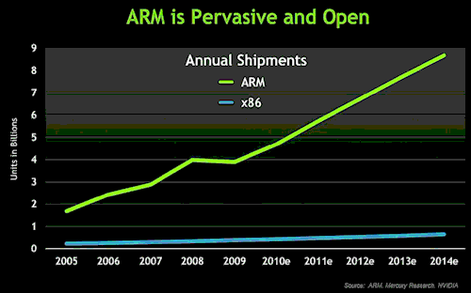
Future Computer Systems
Most likely be a hybrid design
  Think standard multicore chips and accelerator (GPUs)
Today accelerators are attached
Next generation more integrated
Intel’s MIC architecture “Knights Ferry” and “Knights Corner” to come.
  48 x86 cores
AMD’s Fusion in 2012 - 2013
  Multicore with embedded graphics ATI
Nvidia’s Project Denver plans to develop an integrated chip using ARM architecture in 2013.

Slide 6
Major change to Software
Must rethink the design of our software
  Another disruptive technology
    Similar to what happened with cluster computing
    and message passing
  Rethink and rewrite the applications, algorithms, and
  software
Numerical libraries for example will change
  For example, both LAPACK and ScaLAPACK will
  undergo major changes to accommodate this

Slide 7
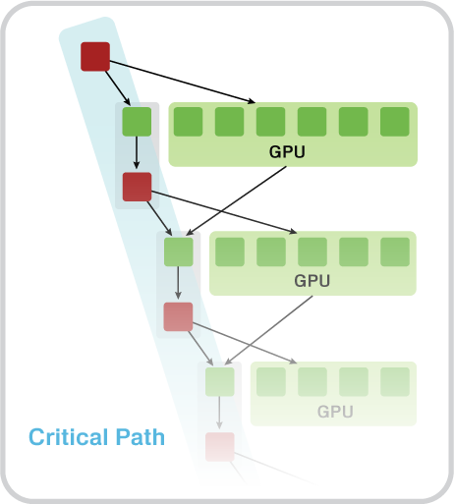
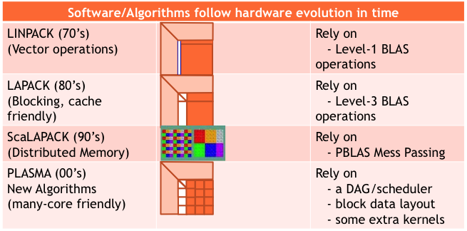
A Next Generation of Software
MAGMA
Hybrid Algorithms
(heterogeneity friendly)
Those new algorithms
- have a very low granularity, they scale very well (multicore, petascale computing, … )
- removes of dependencies among the tasks, (multicore, distributed computing)
- avoid latency (distributed computing, out-of-core)
- rely on fast kernels
Those new algorithms need new kernels and rely on efficient scheduling algorithms.
Rely on
- hybrid scheduler (of DAGs)
- hybrid kernels
(for nested parallelism)
- existing software infrastructure

Slide 8
HPC @ 1/10th the cost & 1/20th the power
LU Factorization in double precision (DP)
[ for solving a dense linear system ]
Hessenberg factorization in DP
[ for the general eigenvalue problem ]
1,090 MFlop/W*
55 MFlop/W*
GPU Fermi C2050 [448 CUDA Cores @ 1.15 GHz ] CPU AMD ISTANBUL
+ Intel Q9300 [ 4 cores @ 2.50 GHz] [ 8 sockets x 6 cores (48 cores) @2.8GHz ]
DP peak 515 + 40 GFlop/s DP peak 538 GFlop/s
System cost ~ $3,000 System cost ~ $30,000
Power * ~ 220 W Power * ~ 1,022 W
* Computation consumed power rate (total system rate minus idle rate), measured with KILL A WATT PS, Model P430

Slide 9
Matrix Algebra on GPU and Multicore Architectures (MAGMA)
MAGMA: a collection of next generation linear algebra (LA) libraries to
achieve the fastest possible time to an accurate solution
on hybrid/heterogeneous architectures
Homepage: http://icl.cs.utk.edu/magma/
Key features
  Top performance and high accuracy (LAPACK compliant)
  Multiple precision arithmetic (S/D/C/Z & mixed)
  Hybrid algorithms using both multicore CPUs and accelerators (GPUs)
MAGMA developers/collaborators
  U of Tennessee, Knoxville; U of California, Berkeley; U of Colorado, Denver
  INRIA Bordeaux - Sud Ouest & INRIA Paris – Saclay, France; KAUST, Saudi Arabia
  Community effort [similarly to the development of LAPACK / ScaLAPACK]

Slide 10
Challenges of using GPUs
High levels of parallelism
Many GPU cores
[ e.g. Tesla C2050 (Fermi) has 448 CUDA cores ]
Hybrid/heterogeneous architectures
Match algorithmic requirements to architectural strengths
[ e.g. small, non-parallelizable tasks to run on CPU, large and parallelizable on GPU ]
Compute vs communication gap
Exponentially growing gap; persistent challenge
[ Processor speed improves 59%, memory bandwidth 23%, latency 5.5% ]
[ on all levels, e.g. a GPU Tesla C1070 (4 x C1060) has compute power of
O(1,000) Gflop/s but GPUs communicate through the CPU using
O(1) GB/s connection ]

Slide 11
MAGMA Software Stack
C P U
H Y B R I D
G P U
distr.
Tile & LAPACK Algorithms
MAGNUM / Rectangular / PLASMA Tile Algorithms
multi
PLASMA, Quark
StarPU, DAGuE, Static (+Dynamic)
LAPACK Algorithms and Tile Kernels
MAGMA 1.0
MAGMA SPARSE
single
MAGMA BLAS
LAPACK
BLAS
BLAS
CUDA / OpenCL for GPUs; MIC
Linux, Windows, Mac OS X | C/C++, Fortran | Matlab, Python

Slide 12
MAGMA 1.0
35+ algorithms are developed (total of 130+ routines)
  Every algorithm is in 4 precisions
  (s/c/d/z, denoted by X)
    - One-sided factorizations and solvers
    - Two-sided factorizations and eigen/singular-value solvers
  There are 3 mixed precision algorithms
  (zc & ds, denoted by XX)
  These are hybrid algorithms
    - Expressed in terms of BLAS
Support is for single CUDA-enabled NVIDIA GPU, either Tesla or Fermi
MAGMA BLAS
  A subset of GPU BLAS, optimized for Tesla and Fermi GPUs

Slide 13
MAGMA 1.0
One-sided factorizations
1. Xgetrf | LU factorization; CPU interface
2. Xgetrf_gpu | LU factorization; GPU interface
3. Xgetrf_mc | LU factorization on multicore (no GPUs)
4. Xpotrf | Cholesky factorization; CPU interface
5. Xpotrf_gpu | Cholesky factorization; GPU interface
6. Xpotrf_mc | Cholesky factorization on multicore (no GPUs)
7. Xgeqrf | QR factorization; CPU interface
8. Xgeqrf_gpu | QR factorization; GPU interface; with T matrices stored
9. Xgeqrf2_gpu | QR factorization; GPU interface; without T matrices
10. Xgeqrf_mc | QR factorization on multicore (no GPUs)
11. Xgeqrf2 | QR factorization; CPU interface
12. Xgeqlf | QL factorization; CPU interface
13. Xgelqf | LQ factorization; CPU interface

Slide 14
MAGMA 1.0
Linear solvers
14. Xgetrs_gpu | Work precision; using LU factorization; GPU interface
15. Xpotrs_gpu | Work precision; using Cholesky factorization; GPU interface
16. Xgels_gpu | Work precision LS; GPU interface
17. XXgetrs_gpu | Mixed precision iterative refinement solver; Using LU factorization; GPU interface
18. XXpotrs_gpu | Mixed precision iterative refinement solver; Using Cholesky factorization; GPU interface
19. XXgeqrsv_gpu | Mixed precision iterative refinement solver; Using QR on square matrix; GPU interface

Slide 15
MAGMA 1.0
Two-sided factorizations
20. Xgehrd | Reduction to upper Hessenberg form; with T matrices stored; CPU interface
21. Xgehrd2 | Reduction to upper Hessenberg form; Without the T matrices stored; CPU interface
22. Xhetrd | Reduction to tridiagonal form; CPU interface
23. Xgebrd | Reduction to bidiagonal form; CPU interface

Slide 16
MAGMA 1.0
Generating/applying orthogonal matrices
24. Xungqr | Generates Q with orthogonal columns as the product of elementary reflectors (from Xgeqrf); CPU interface
25. Xungqr_gpu | Generates Q with orthogonal columns as the product of elementary reflectors (from Xgeqrf_gpu); GPU interface
26. Xunmtr | Multiplication with the orthogonal matrix, product of elementary reflectors from Xhetrd; CPU interface
27. Xunmtr_gpu | Multiplication with the orthogonal matrix, product of elementary reflectors from Xhetrd; GPU interface
28. Xunmqr | Multiplication with orthogonal matrix, product of elementary reflectors from Xgeqrf; CPU interface
29. Xunmqr_gpu | Multiplication with orthogonal matrix, product of elementary reflectors from Xgeqrf_gpu; GPU interface
30. Xunghr | Generates Q with orthogonal columns as the product of elementary reflectors (from Xgehrd); CPU interface
31. Xunghr_gpu | Generates Q with orthogonal columns as the product of elementary reflectors (from Xgehrd); GPU interface

Slide 17
MAGMA 1.0
Eigen/singular-value solvers
32. Xgeev | Solves the non-symmetric eigenvalue problem; CPU interface
33. Xheevd | Solves the Hermitian eigenvalue problem; Uses devide and conquer; CPU interface
34. Xgesvd | SVD; CPU interface
Currently, these routines have
GPU-acceleration for the
  two-sided factorizations used and the
  Orthogonal transformation related to them
  (matrix generation/application from the
  previous slide)

Slide 18
MAGMA BLAS
Subset of BLAS for a single NVIDIA GPU
Optimized for MAGMA specific algorithms
To complement CUBLAS on special cases

Slide 19
MAGMA BLAS
Level 2 BLAS
1. Xgemv_tesla | General matrix-vector product for Tesla
2. Xgemv_fermi | General matrix-vector product for Fermi
3. Xsymv_ tesla | Symmetric matrix-vector product for Tesla
4. Xsymv_fermi | Symmetric matrix-vector product for Fermi

Slide 20
MAGMA BLAS
Level 3 BLAS
5. Xgemm_tesla | General matrix-matrix product for Tesla
6. Xgemm_fermi | General matrix-matrix product for Fermi
7. Xtrsm_ tesla | Solves a triangular matrix problem on Tesla
8. Xtrsm_fermi | Solves a triangular matrix problem on Fermi
9. Xsyrk_tesla | Symmetric rank k update for Tesla
10. Xsyr2k_tesla | Symmetric rank 2k update for Tesla
CUBLAS GEMMs for Fermi are based on the MAGMA implementation
Further improvements
– Autotuned GEMM for Fermi (J.Kurzak)
– ZGEMM from 308 Gflop/s is now 341 Gflop/s

Slide 21
MAGMA BLAS
Other routines
11. Xswap | LU factorization; CPU interface
12. Xlacpy | LU factorization; GPU interface
13. Xlange | LU factorization on multicore (no GPUs)
14. Xlanhe | Cholesky factorization; CPU interface
15. Xtranspose | Cholesky factorization; GPU interface
16. Xinplace_transpose | Cholesky factorization on multicore (no GPUs)
17. Xpermute | QR factorization; CPU interface
18. Xauxiliary | QR factorization; GPU interface; with T matrices stored

Slide 22
Methodology overview
MAGMA uses HYBRIDIZATION methodology based on
  Representing linear algebra algorithms as collections
  of TASKS and DATA DEPENDENCIES among them
  Properly SCHEDULING tasks' execution over
  multicore and GPU hardware components
Successfully applied to fundamental
linear algebra algorithms
  One and two-sided factorizations and solvers
  Iterative linear and eigen-solvers
Productivity
  High-level
  Leveraging prior developments
  Exceeding in performance homogeneous solutions
Hybrid CPU+GPU algorithms
(small tasks for multicores and large
tasks for GPUs)

Slide 23
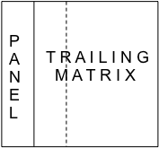
Statically Scheduled One-Sided Factorizations
(LU, QR, and Cholesky)
Hybridization
  Panels (Level 2 BLAS) are factored on CPU using LAPACK
  Trailing matrix updates (Level 3 BLAS) are done on the
  GPU using “look-ahead”
Note
  Panels are memory bound but are only O(N²) flops and can be overlapped
  with the O(N³) flops of the updates
  In effect, the GPU is used only for the high-performance Level 3 BLAS updates,
  i.e., no low performance Level 2 BLAS is scheduled on the GPU

Slide 24
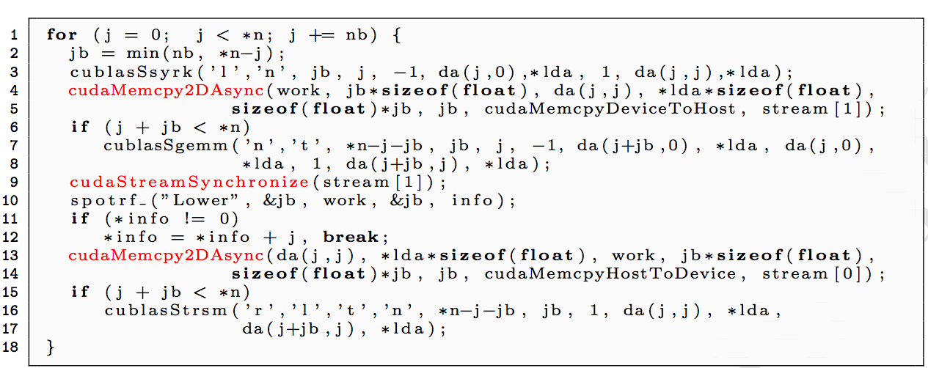
A hybrid algorithm example
Left-looking hybrid Cholesky factorization in MAGMA 1.0
The difference with LAPACK – the 3 additional lines in red
Line 10 (done on CPU) is overlapped with work on the GPU (line 7)

Slide 25
Results – one sided factorizations
LU Factorization in double precision
FERMI Tesla C2050: 448 CUDA cores @ 1.15GHz
SP/DP peak is 1030 / 515 GFlop/s
ISTANBUL AMD 8 socket 6 core (48 cores) @2.8GHz
SP/DP peak is 1075 / 538 GFlop/s
Similar results for Cholesky & QR
Fast solvers (several innovations)
- in working precision, and
- mixed-precision iter. refinement
based on the one-sided factor.

Slide 26
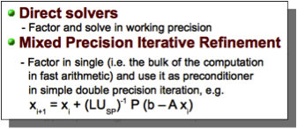
Results – linear solvers
MAGMA LU-based solvers on Fermi (C2050)
FERMI Tesla C2050: 448 CUDA cores @ 1.15GHz
SP/DP peak is 1030 / 515 GFlop/s
Similar results for Cholesky & QR

Slide 27
Results – two sided factorizations
Hessenberg Factorization in double precision
[ for the general eigenvalue problem ]
FERMI Tesla C2050: 448 CUDA cores @ 1.15GHz
SP/DP peak is 1030 / 515 Gflop/s
[ system cost ~ $3,000 ]
ISTANBUL AMD 8 socket 6 core (48 cores) @2.8GHz
SP/DP peak is 1075 / 538 Gflop/s
[ system cost ~ $30,000 ]
Similar accelerations for the
bidiagonal factorization [for SVD] &
tridiagonal factorization [for the
symmetric eigenvalue problem]
Similar acceleration (exceeding 10x)
compared to other top-of-the-line
multicore systems (including
Nehalem-based) and libraries
(including MKL, ACML)

Slide 28
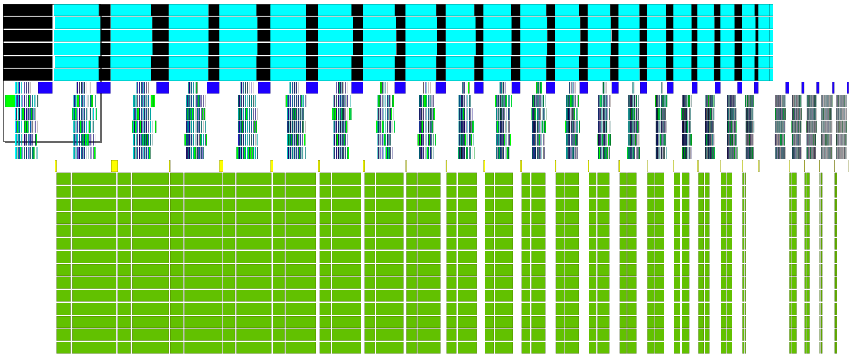
GPU + Multicore one-sided factorizations
Parallel, dynamically scheduled panel factorizations (w/ QUARK) on multicore
Parallel updates on multicore
Parallel updates on GPU
Hybrid QR factorization trace for matrix of size 3360 x 3360
w/ Mitch Horton

Slide 29
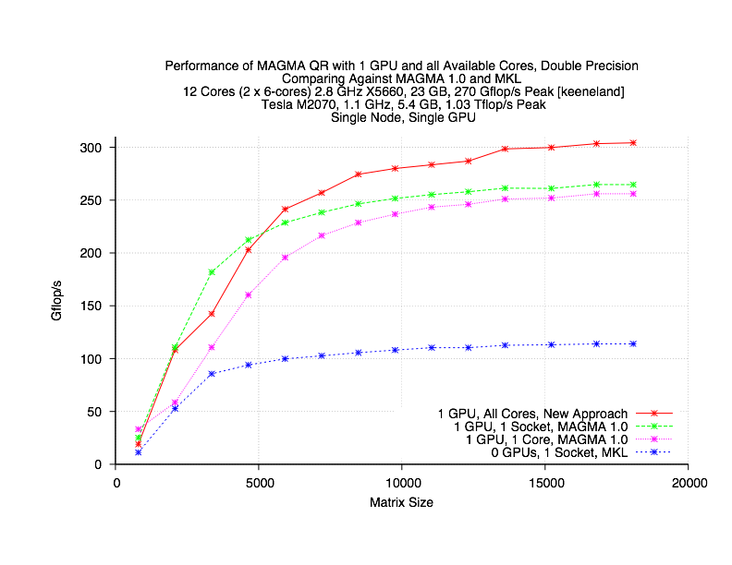
A QR for GPU + Multicore

Slide 30
Multicore + multiGPU tiled algorithms
Reuse already developed kernels
  Hybrid MAGMA 1.0 for single GPU
  PLASMA for multicore
We have developed tiled one-sided factorization algorithms
Use various run time systems to schedule the kernels’ execution
  StarPU (Dynamic scheduling on a node)
  QUARK (Dynamic on multicore node from PLASMA)
  Static + Dynamic scheduling
  DAGuE

Slide 31
Tiled algorithms with StarPU
Productivity – easy to develop parallel multicore & multiGPU
algorithms from sequential algorithms
Developed are LU, QR, and Cholesky factorization algorithms
The kernels needed are available to use w/ other schedulers
// Sequential Tile Cholesky
FOR k = 0..TILES-1
DPOTRF(A[k][k])
FOR m = k+1..TILES-1
DTRSM(A[k][k], A[m][k])
FOR n = k+1..TILES-1
DSYRK(A[n][k], A[n][n])
FOR m = n+1..TILES-1
DGEMM(A[m][k], A[n][k], A[m][n])
// Hybrid Tile Cholesky
FOR k = 0..TILES-1
starpu_Insert_Task(DPOTRF, …)
FOR m = k+1..TILES-1
starpu_Insert_Task(DTRSM, …)
FOR n = k+1..TILES-1
starpu_Insert_Task(DSYRK, …)
FOR m = n+1..TILES-1
starpu_Insert_Task(DGEMM, …)
w/ E. Aggulo, C. Augonnet, M. Faverge, H. Ltaief

Slide 32
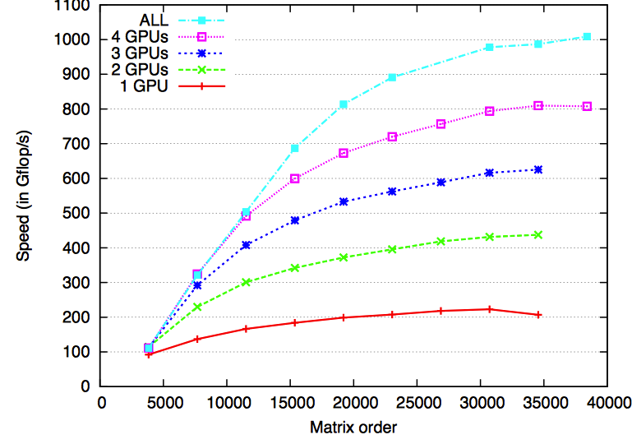
MAGMA with StarPU
QR factorization
  System: 16 CPUs (AMD) + 4 GPUs (C1060)

Slide 33
Static + Dynamic Scheduling
Dynamic schedulers provide ease of development
Static scheduling allows more flexible design, e.g., to minimize communication
We have explored combination of
  Static data distribution and communication between node
  Dynamic scheduling within a node
Developed are QR and Cholesky for single and distributed multicore and multiGPU nodes
w/ Fengguang Song

Slide 34
Distributed GPUs
on Keeneland nodes – 12 CPU cores and 3 Fermi GPUs
Weak scalability – Cholesky factorization in DP
75 Tflops

Slide 35
Complete Eigensolvers
Generalized Hermitian-definite eigenproblem solver ( A x = λ B x )
[double complex arithmetic; based on Divide & Conquer; eigenvalues + eigenvectors]
w/ R. Solca, T. Schulthess, W. Sawyer,
A. Haidar, C. Vomel
GPU Fermi C2050 [448 CUDA Cores @ 1.15 GHz ] CPU AMD ISTANBUL
+ Intel Q9300 [ 4 cores @ 2.50 GHz] [ 8 sockets x 6 cores (48 cores) @2.8GHz ]
DP peak 515 + 40 GFlop/s DP peak 538 GFlop/s
System cost ~ $3,000 System cost ~ $30,000
Power * ~ 220 W Power * ~ 1,022 W
* Computation consumed power rate (total system rate minus idle rate), measured with KILL A WATT PS, Model P430

Slide 36
MAGMA BLAS
SGEMM and M3 CGEMM
DGEMM and M3 ZGEMM
63% of peak
58% of peak
Tesla C2050 (Fermi): 448 CUDA cores @ 1.15GHz, theoretical SP peak is 1.03 Tflop/s, DP is 515 GFlop/s)
Performance critically depend on BLAS
On going efforts on developing highly optimized BLAS for NVIDIA GPUs in CUDA
  CUBLAS 3.2 GEMM are based on the MAGMA kernels
  TRSM and other Level 3 BLAS based on GEMM
  HEMV / SYMV (accepted at SC11)
Auto-tuning has become more important …
w/ R. Nath, P. Du, T. Dong

Slide 37
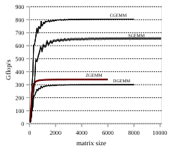
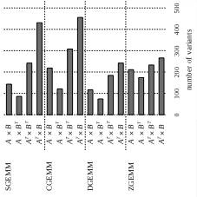
Autotuning
Autotuning framework
  will define stencils for kernels
  Generate implementations while
  pruning the search space
  Empirically find the fastest implementation
Performance of GEMM on Fermi (C2050)
An example – Autotuning GEMM on Fermi (C2050):
ZGEMM improved significantly
compared to CUBLAS
  from 308 to 341 Gflop/s
Improvement up to 2x on
some specific matrices
(e.g., of “rectangular” shape)
w/ J. Kurzak, P. Luszczek

Slide 38
Future directions
Hybrid algorithms
  Further expend functionality,
  including support for certain sparse LA algorithms
  New highly parallel algorithms of optimized communication and synchronization
OpenCL support (to increase MAGMA’s portability)
  To be derived from OpenCL BLAS
MIC support
Autotuning
  On both high level algorithms & BLAS
Multi-GPU algorithms, including distributed
  Scheduling
  Further expand functionality

Slide 39







Collaborators / Support
MAGMA [Matrix Algebra on GPU
and Multicore Architectures] team
http://icl.cs.utk.edu/magma/
PLASMA [Parallel Linear Algebra
for Scalable Multicore
Architectures] team
http://icl.cs.utk.edu/plasma
Collaborating partners
University of Tennessee, Knoxville
University of California, Berkeley
University of Colorado, Denver
INRIA, France
KAUST, Saudi Arabia

