Slide 1
Matrix Algebra on GPU and
Multicore Architectures
Stan Tomov
Research Director
Innovative Computing Laboratory
Department of Computer Science
University of Tennessee, Knoxville
Workshop on GPU-enabled Numerical Libraries
University of Basel, Switzerland
May 11-13, 2011

Slide 2
Outline
PART I
  Introduction to MAGMA
  Methodology
  Performance
PART II
  Hands-on training
  Using and contributing to MAGMA
  Examples

Slide 3
Part I: Outline
Motivation
MAGMA – LAPACK for GPUs
  Overview
  Methodology
  MAGMA with StarPU / PLASMA / Quark
MAGMA BLAS
Sparse iterative linear algebra
Current & future work directions
Conclusions

Slide 4
Part I: Outline Goals
Motivation [ Hardware to Software Trends ]
MAGMA – LAPACK for GPUs
  Overview [ Learn what is available, how to use it, etc. ]
  Methodology [ How to develop, e.g., hybrid algorithms ]
  MAGMA with StarPU / PLASMA / Quark [ Development tools ]
MAGMA BLAS [ Highly optimized CUDA kernels ]
Sparse iterative linear algebra [ Methodology use in sparse LA ]
Current & future work directions
Conclusions

Slide 5

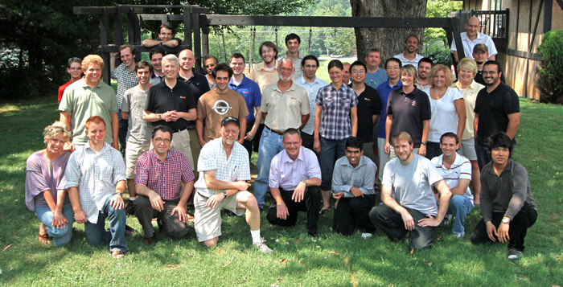
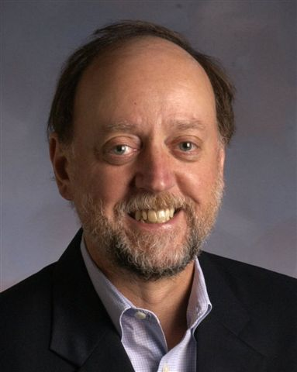
About ICL
Last year ICL celebrated
20 years anniversary!
staff of more than
40 researchers,
students, and
administrators
Established by
Prof. Jack Dongarra
Mission – provide leading edge tools, enable technologies and software for scientific computing, develop standards for scientific computing in general
This includes standards and efforts such as
PVM, MPI, LAPACK, ScaLAPACK, BLAS, ATLAS, Netlib, Top 500, PAPI, NetSolve, and the Linpack Benchmark
ICL continues these efforts with
PLASMA, MAGMA, HPC Challenge, BlackJack, OpenMPI, and MuMI,
as well as other innovative computing projects

Slide 6
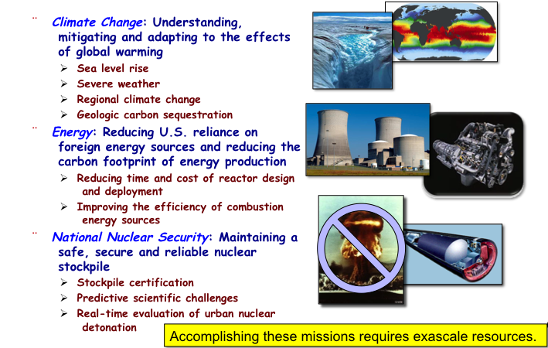
Science and Engineering Drivers

Slide 7
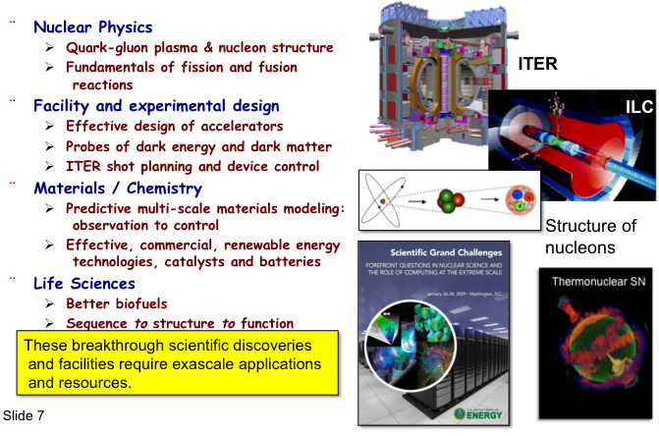
Simulation enables fundamental advances in basic science

Slide 8
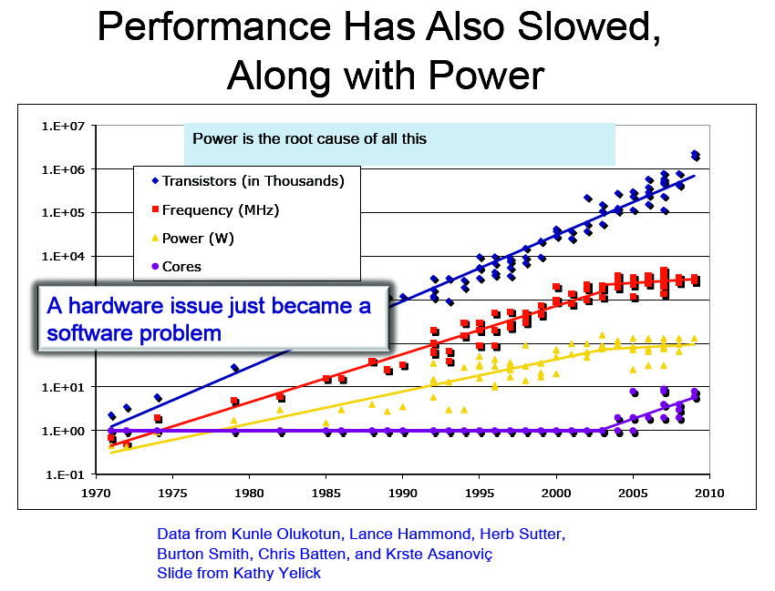
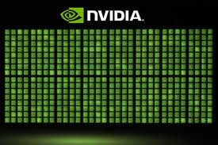
Hardware Trends
Power consumption and the
move towards multicore
Hybrid architectures
GPU
Hybrid GPU-based systems
  CPU and GPU to get integrated
  (NVIDIA to make ARM CPU
  cores alongside GPUs)
x86 host
DMA
host
memory
7.5 GB/s
PCI-e 3.0

Slide 9
Performance Development in Top500
100 Pflop/s
10 Pflop/s
N=1
1 Pflop/s
Gordon
Bell
Winners
100 Tflop/s
10 Tflop/s
1 Tflop/s
N=500
100 Gflop/s
10 Gflop/s
1 Gflop/s
100 Mflop/s

Slide 10
36rd List: The TOP10
Rank | Site | Computer | Country | Cores | Rmax [Pflops] | % of Peak | Power [MW] | Flops/Watt
1 | Nat. SuperComputer Center in Tianjin | Tianhe-1A, NUDT Intel + Nvidia GPU + custom | China | 186,368 | 2.57 | 55 | 4.04 | 636
2 | DOE / OS Oak Ridge Nat Lab | Jaguar, Cray AMD + custom | USA | 224,162 | 1.76 | 75 | 7.0 | 251
3 | Nat. Supercomputer Center in Shenzhen | Nebulea, Dawning Intel + Nvidia GPU + IB | China | 120,640 | 1.27 | 43 | 2.58 | 493
4 | GSIC Center, Tokyo Institute of Technology | Tusbame 2.0, HP Intel + Nvidia GPU + IB | Japan | 73,278 | 1.19 | 52 | 1.40 | 850
5 | DOE / OS Lawrence Berkeley Nat Lab | Hopper, Cray AMD + custom | USA | 153,408 | 1.054 | 82 | 2.91 | 362
6 | Commissariat a l'Energie Atomique (CEA) | Tera-10, Bull Intel + IB | France | 138,368 | 1.050 | 84 | 4.59 | 229
7 | DOE / NNSA Los Alamos Nat Lab | Roadrunner, IBM AMD + Cell GPU + IB | USA | 122,400 | 1.04 | 76 | 2.35 | 446
8 | NSF / NICS U of Tennessee | Kraken, Cray AMD + custom | USA | 98,928 | .831 | 81 | 3.09 | 269
9 | Forschungszentrum Juelich (FZJ) | Jugene, IBM Blue Gene + custom | Germany | 294,912 | .825 | 82 | 2.26 | 365
10 | DOE / NNSA LANL & SNL | Cielo, Cray AMD + custom | USA | 107,152 | .817 | 79 | 2.95 | 277

Slide 11
36rd List: The TOP10
Rank | Site | Computer | Country | Cores | Rmax [Pflops] | % of Peak | Power [MW] | GFlops/Watt
1 | Nat. SuperComputer Center in Tianjin | Tianhe-1A, NUDT Intel + Nvidia GPU + custom | China | 186,368 | 2.57 | 55 | 4.04 | 636
2 | DOE / OS Oak Ridge Nat Lab | Jaguar, Cray AMD + custom | USA | 224,162 | 1.76 | 75 | 7.0 | 251
3 | Nat. Supercomputer Center in Shenzhen | Nebulea, Dawning Intel + Nvidia GPU + IB | China | 120,640 | 1.27 | 43 | 2.58 | 493
4 | GSIC Center, Tokyo Institute of Technology | Tusbame 2.0, HP Intel + Nvidia GPU + IB | Japan | 73,278 | 1.19 | 52 | 1.40 | 850
5 | DOE / OS Lawrence Berkeley Nat Lab | Hopper, Cray AMD + custom | USA | 153,408 | 1.054 | 82 | 2.91 | 362
6 | Commissariat a l'Energie Atomique (CEA) | Tera-10, Bull Intel + IB | France | 138,368 | 1.050 | 84 | 4.59 | 229
7 | DOE / NNSA Los Alamos Nat Lab | Roadrunner, IBM AMD + Cell GPU + IB | USA | 122,400 | 1.04 | 76 | 2.35 | 446
8 | NSF / NICS U of Tennessee | Kraken, Cray AMD + custom | USA | 98,928 | .831 | 81 | 3.09 | 269
9 | Forschungszentrum Juelich (FZJ) | Jugene, IBM Blue Gene + custom | Germany | 294,912 | .825 | 82 | 2.26 | 365
10 | DOE / NNSA LANL & SNL | Cielo, Cray AMD + custom | USA | 107,152 | .817 | 79 | 2.95 | 277

Slide 12
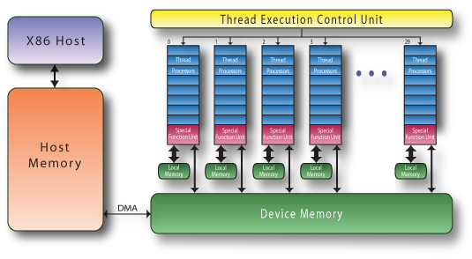
Commodity plus Accelerators
Commodity
Accelerator (GPU)
Intel Xeon
8 cores
3 GHz
8*4 ops/cycle
96 Gflop/s (DP)
NVIDIA C2050 “Fermi”
448 “CUDA cores”
1.15 GHz
448 ops/cycle
515 Gflop/s (DP)
Interconnect
PCI-X 16 lane
64 Gb/s
1 GW/s
17 systems on the TOP500 use GPUs as accelerators

Slide 13
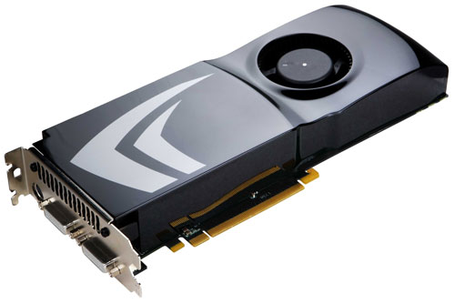
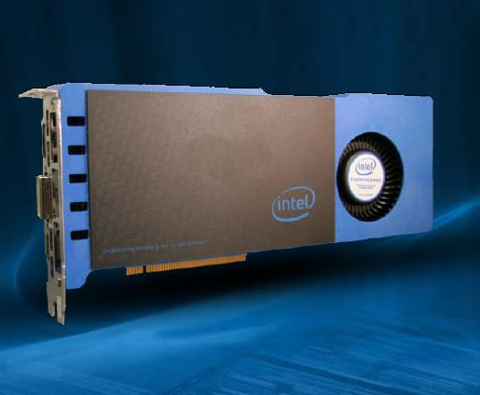


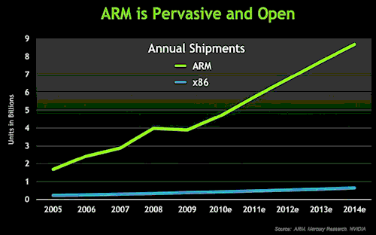
Future Computer Systems
Most likely be a hybrid design
  Think standard multicore chips and accelerator (GPUs)
Today accelerators are attached
Next generation more integrated
Intel’s MIC architecture “Knights Ferry” and “Knights Corner” to come.
  48 x86 cores
AMD’s Fusion in 2012 - 2013
  Multicore with embedded graphics ATI
Nvidia’s Project Denver plans to develop an integrated chip using ARM architecture in 2013.

Slide 14
Major change to Software
Must rethink the design of our software
  Another disruptive technology
    Similar to what happened with cluster computing
    and message passing
  Rethink and rewrite the applications, algorithms, and
  software
Numerical libraries for example will change
  For example, both LAPACK and ScaLAPACK will
  undergo major changes to accommodate this

Slide 15
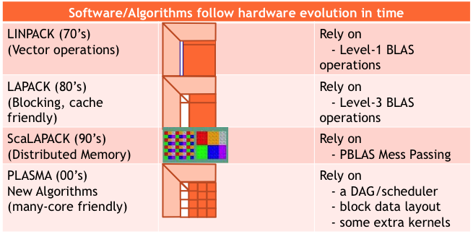
A New Generation of Software

Slide 16
A New Generation of Software

Slide 17
A New Generation of Software

Slide 18
A New Generation of Software
Those new algorithms
- have a very low granularity, they scale very well (multicore, petascale computing, … )
- removes of dependencies among the tasks, (multicore, distributed computing)
- avoid latency (distributed computing, out-of-core)
- rely on fast kernels
Those new algorithms need new kernels and rely on efficient scheduling algorithms.

Slide 19
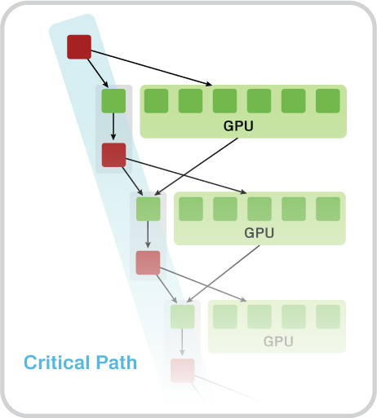
A New Generation of Software
MAGMA
Hybrid Algorithms
(heterogeneity friendly)
Those new algorithms
- have a very low granularity, they scale very well (multicore, petascale computing, … )
- removes of dependencies among the tasks, (multicore, distributed computing)
- avoid latency (distributed computing, out-of-core)
- rely on fast kernels
Those new algorithms need new kernels and rely on efficient scheduling algorithms.
Rely on
- hybrid scheduler (of DAGs)
- hybrid kernels
(for nested parallelism)
- existing software infrastructure

Slide 20
Challenges of using GPUs
High levels of parallelism
Many GPU cores
[ e.g. Tesla C2050 (Fermi) has 448 CUDA cores ]
Hybrid/heterogeneous architectures
Match algorithmic requirements to architectural strengths
[ e.g. small, non-parallelizable tasks to run on CPU, large and parallelizable on GPU ]
Compute vs communication gap
Exponentially growing gap; persistent challenge
[ Processor speed improves 59%, memory bandwidth 23%, latency 5.5% ]
[ on all levels, e.g. a GPU Tesla C1070 (4 x C1060) has compute power of
O(1,000) Gflop/s but GPUs communicate through the CPU using
O(1) GB/s connection ]

Slide 21
Matrix Algebra on GPU and Multicore Architectures (MAGMA)
MAGMA: a new generation linear algebra (LA) libraries to achieve the fastest possible
time to an accurate solution on hybrid/heterogeneous architectures
Homepage: http://icl.cs.utk.edu/magma/
MAGMA & LAPACK
  MAGMA uses LAPACK and extends its functionality to hybrid systems (w/ GPUs);
  MAGMA is designed to be similar to LAPACK in
  functionality, data storage and interface
  MAGMA leverages years of experience in developing open source LA software packages like LAPACK, ScaLAPACK, BLAS, ATLAS, and PLASMA
MAGMA developers/collaborators
  U of Tennessee, Knoxville; U of California, Berkeley; U of Colorado, Denver
  INRIA Bordeaux - Sud Ouest & INRIA Paris – Saclay, France; KAUST, Saudi Arabia
  Community effort [similarly to the development of LAPACK / ScaLAPACK]

Slide 22
PLASMA
Parallel Linear Algebra Software for Multicore Architectures

Slide 23
PLASMA
Parallel Linear Algebra Software for Multicore Architectures
Asychronicity
  Avoid fork-join (Bulk sync design)
Dynamic Scheduling
  Out of order execution
Fine Granularity
  Independent block operations
Locality of Reference
  Data storage – Block Data Layout

Slide 24
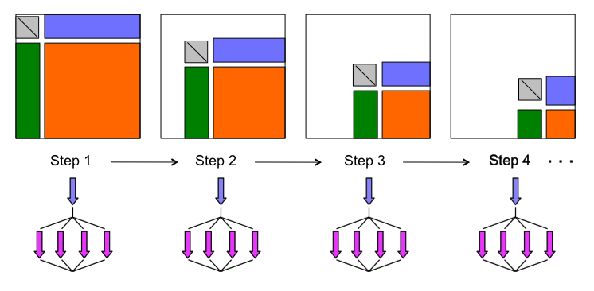
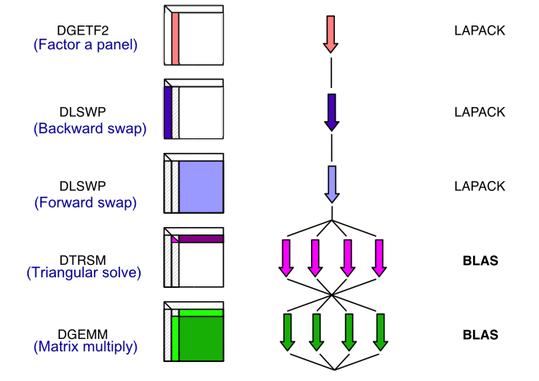

LAPACK LU
fork join
bulk synchronous processing

Slide 25
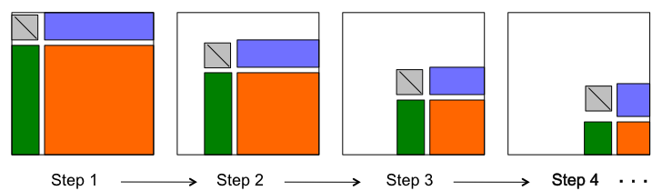
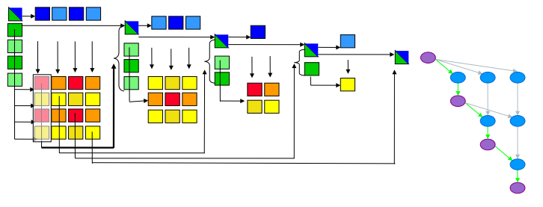
Parallel tasks in LU
Idea: break into smaller tasks and remove dependencies
Objectives: high utilization of each core, scaling to large number of cores
Methodology: Arbitrary DAG scheduling, Fine granularity / block data layout

Slide 26
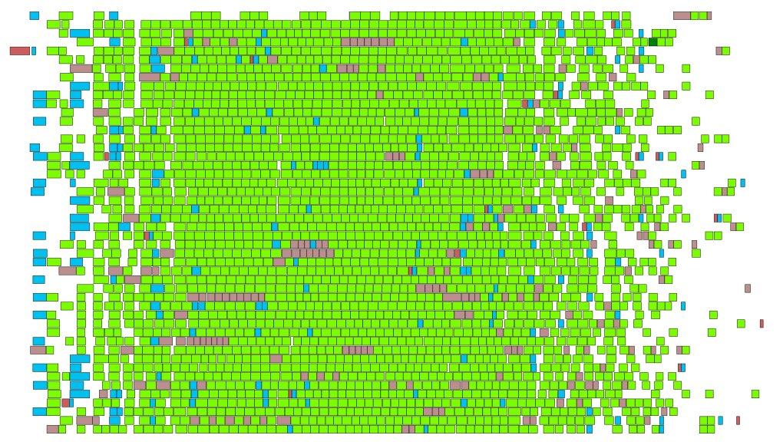
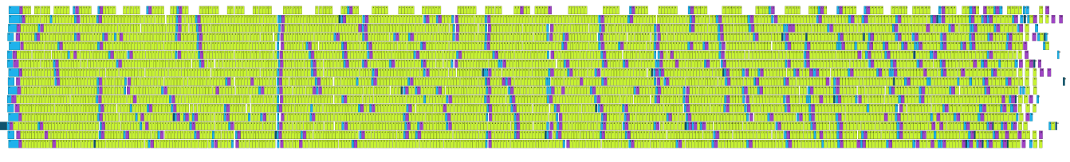
PLASMA Scheduling
Dynamic Scheduling: Tile LU Trace
  Regular trace
  Factorization steps pipelined
  Stalling only due to natural load imbalance
8-socket, 6-core (48 cores total) AMD Istanbul 2.8 GHz
quad-socket quad-core Intel Xeon 2.4 GHz

Slide 27
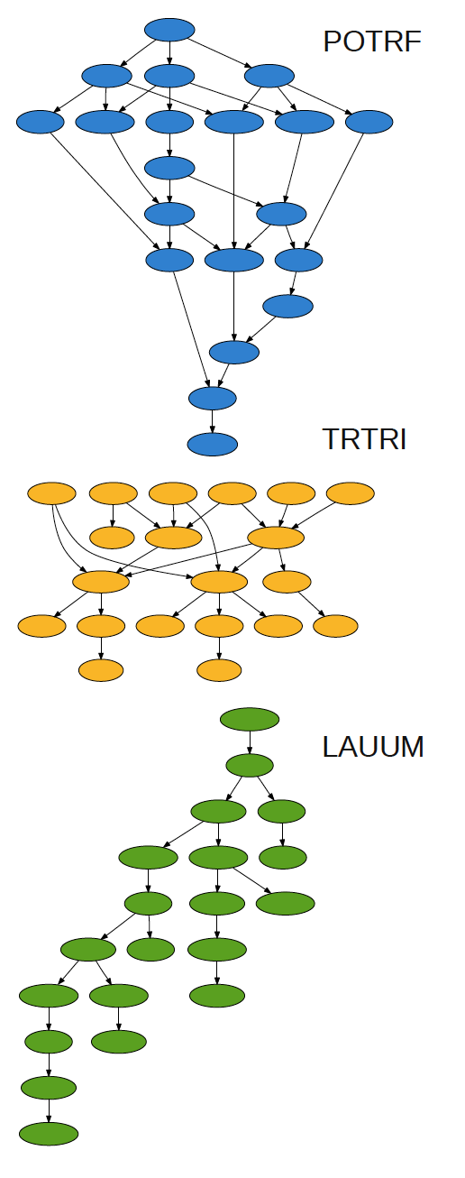
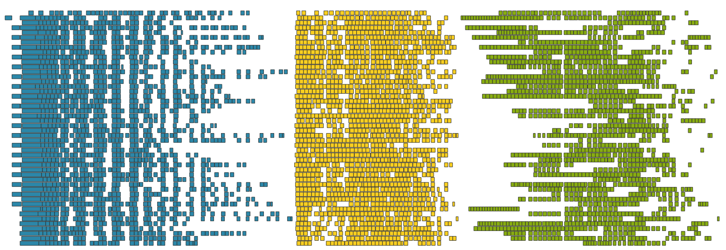
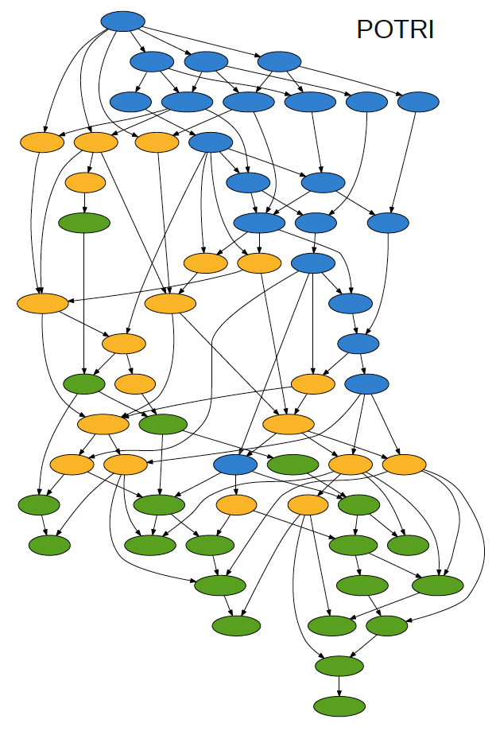
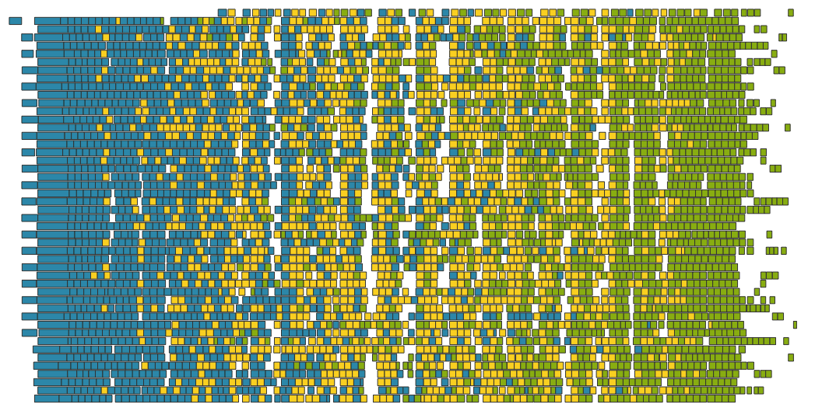
Pipelining: Cholesky Inversion
48 cores
POTRF, TRTRI and LAUUM.
The matrix is 4000 x 4000,tile size is 200 x 200,

Slide 28
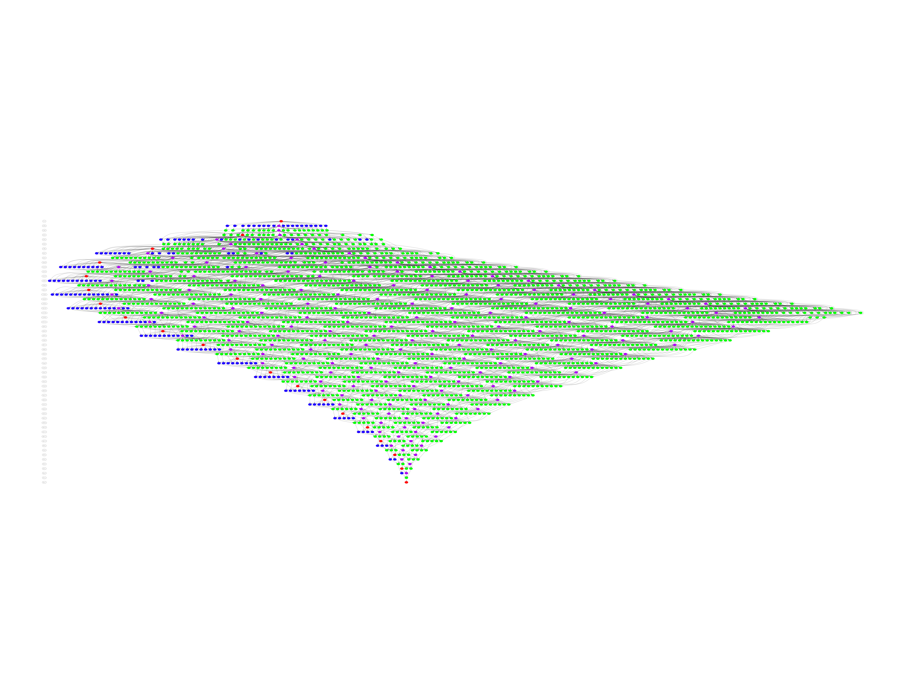
Big DAGs: No Global Critical Path
DAGs get very big, very fast
  So windows of active tasks are used; this means no global critical path
  Matrix of NBxNB tiles; NB³ operation
    NB=100 gives 1 million tasks

Slide 29
PLASMA Performance (QR, 48 cores)

Slide 30
MAGMA
Matrix Algebra on GPU and Multicore Architectures

Slide 31
MAGMA Software Stack
C P U
H Y B R I D
G P U
distr.
Tile & LAPACK Algorithms with DAGuE
MAGNUM / Rectangular / PLASMA Tile Algorithms
multi
PLASMA / Quark
StarPU
LAPACK Algorithms and Tile Kernels
MAGMA 1.0
MAGMA SPARSE
single
MAGMA BLAS
LAPACK
BLAS
BLAS
CUDA
Linux, Windows, Mac OS X | C/C++, Fortran | Matlab, Python

Slide 32
MAGMA 1.0
32 algorithms are developed (total – 122 routines)
  Every algorithm is in 4 precisions
  (s/c/d/z, denoted by X)
  There are 3 mixed precision algorithms
  (zc & ds, denoted by XX)
  These are hybrid algorithms
  Expressed in terms of BLAS
Support is for single CUDA-enabled NVIDIA GPU, either Tesla or Fermi
MAGMA BLAS
  A subset of GPU BLAS, optimized for Tesla and Fermi GPUs

Slide 33
MAGMA 1.0
One-sided factorizations
1. Xgetrf | LU factorization; CPU interface
2. Xgetrf_gpu | LU factorization; GPU interface
3. Xgetrf_mc | LU factorization on multicore (no GPUs)
4. Xpotrf | Cholesky factorization; CPU interface
5. Xpotrf_gpu | Cholesky factorization; GPU interface
6. Xpotrf_mc | Cholesky factorization on multicore (no GPUs)
7. Xgeqrf | QR factorization; CPU interface
8. Xgeqrf_gpu | QR factorization; GPU interface; with T matrices stored
9. Xgeqrf2_gpu | QR factorization; GPU interface; without T matrices
10. Xgeqrf_mc | QR factorization on multicore (no GPUs)
11. Xgeqrf2 | QR factorization; CPU interface
12. Xgeqlf | QL factorization; CPU interface
13. Xgelqf | LQ factorization; CPU interface

Slide 34
MAGMA 1.0
Linear solvers
14. Xgetrs_gpu | Work precision; using LU factorization; GPU interface
15. Xpotrs_gpu | Work precision; using Cholesky factorization; GPU interface
16. Xgels_gpu | Work precision LS; GPU interface
17. XXgetrs_gpu | Mixed precision iterative refinement solver; Using LU factorization; GPU interface
18. XXpotrs_gpu | Mixed precision iterative refinement solver; Using Cholesky factorization; GPU interface
19. XXgeqrsv_gpu | Mixed precision iterative refinement solver; Using QR on square matrix; GPU interface

Slide 35
MAGMA 1.0
Two-sided factorizations
20. Xgehrd | Reduction to upper Hessenberg form; with T matrices stored; CPU interface
21. Xgehrd2 | Reduction to upper Hessenberg form; Without the T matrices stored; CPU interface
22. Xhetrd | Reduction to tridiagonal form; CPU interface
23. Xgebrd | Reduction to bidiagonal form; CPU interface

Slide 36
MAGMA 1.0
Generating/applying orthogonal matrices
24. Xungqr | Generates Q with orthogonal columns as the product of elementary reflectors (from Xgeqrf); CPU interface
25. Xungqr_gpu | Generates Q with orthogonal columns as the product of elementary reflectors (from Xgeqrf_gpu); GPU interface
26. Xunmtr | Multiplication with the orthogonal matrix, product of elementary reflectors from Xhetrd; CPU interface
27. Xunmqr | Multiplication with orthogonal matrix, product of elementary reflectors from Xgeqrf; CPU interface
28. Xunmqr_gpu | Multiplication with orthogonal matrix, product of elementary reflectors from Xgeqrf_gpu; GPU interface
29. Xunghr | Generates Q with orthogonal columns as the product of elementary reflectors (from Xgehrd); CPU interface

Slide 37
MAGMA 1.0
Eigen/singular-value solvers
30. Xgeev | Solves the non-symmetric eigenvalue problem; CPU interface
31. Xheevd | Solves the Hermitian eigenvalue problem; Uses devide and conquer; CPU interface
32. Xgesvd | SVD; CPU interface
Currently, these routines have
GPU-acceleration for the
  two-sided factorizations used and the
  Orthogonal transformation related to them
  (matrix generation/application from the
  previous slide)

Slide 38
MAGMA BLAS
Subset of BLAS for a single NVIDIA GPU
Optimized for MAGMA specific algorithms
To complement CUBLAS on special cases

Slide 39
MAGMA BLAS
Level 2 BLAS
1. Xgemv_tesla | General matrix-vector product for Tesla
2. Xgemv_fermi | General matrix-vector product for Fermi
3. Xsymv_ tesla | Symmetric matrix-vector product for Tesla
4. Xsymv_fermi | Symmetric matrix-vector product for Fermi

Slide 40
MAGMA BLAS
Level 3 BLAS
5. Xgemm_tesla | General matrix-matrix product for Tesla
6. Xgemm_fermi | General matrix-matrix product for Fermi
7. Xtrsm_ tesla | Solves a triangular matrix problem on Tesla
8. Xtrsm_fermi | Solves a triangular matrix problem on Fermi
9. Xsyrk_tesla | Symmetric rank k update for Tesla
10. Xsyr2k_tesla | Symmetric rank 2k update for Tesla
CUBLAS GEMMs for Fermi are based on the MAGMA implementation
Further improvements
– BACUGen - Autotuned GEMM for Fermi (J.Kurzak)
– ZGEMM from 308 Gflop/s is now 341 Gflop/s

Slide 41
MAGMA BLAS
Other routines
11. Xswap | LU factorization; CPU interface
12. Xlacpy | LU factorization; GPU interface
13. Xlange | LU factorization on multicore (no GPUs)
14. Xlanhe | Cholesky factorization; CPU interface
15. Xtranspose | Cholesky factorization; GPU interface
16. Xinplace_transpose | Cholesky factorization on multicore (no GPUs)
17. Xpermute | QR factorization; CPU interface
18. Xauxiliary | QR factorization; GPU interface; with T matrices stored

Slide 42
Methodology overview

Slide 43
Methodology overview
MAGMA uses HYBRIDIZATION methodology based on
  Representing linear algebra algorithms as collections
  of TASKS and DATA DEPENDENCIES among them
  Properly SCHEDULING tasks' execution over
  multicore and GPU hardware components
Successfully applied to fundamental
linear algebra algorithms
  One and two-sided factorizations and solvers
  Iterative linear and eigen-solvers
Productivity
  High-level
  Leveraging prior developments
  Exceeding in performance homogeneous solutions
Hybrid CPU+GPU algorithms
(small tasks for multicores and large
tasks for GPUs)

Slide 44
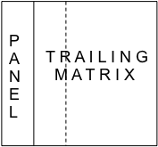
Statically Scheduled One-Sided Factorizations
(LU, QR, and Cholesky)
Hybridization
  Panels (Level 2 BLAS) are factored on CPU using LAPACK
  Trailing matrix updates (Level 3 BLAS) are done on the
  GPU using “look-ahead”
Note
  Panels are memory bound but are only O(N²) flops and can be overlapped
  with the O(N³) flops of the updates
  In effect, the GPU is used only for the high-performance Level 3 BLAS updates,
  i.e., no low performance Level 2 BLAS is scheduled on the GPU

Slide 45
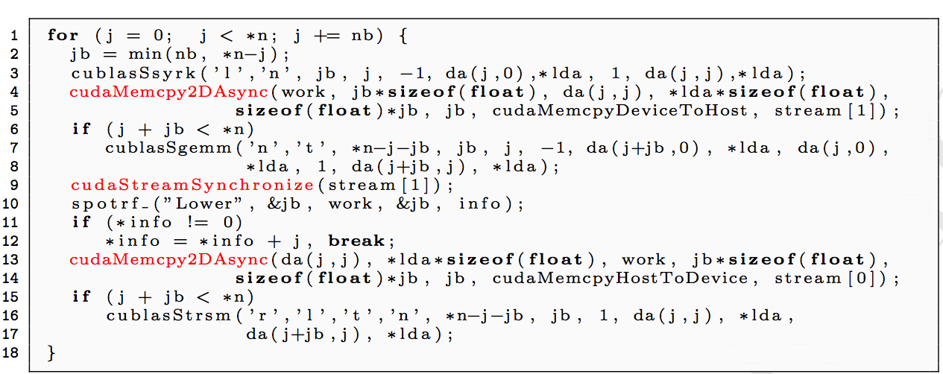
A hybrid algorithm example
Left-looking hybrid Cholesky factorization in MAGMA 1.0
The difference with LAPACK – the 3 additional lines in red
Line 10 (done on CPU) is overlapped with work on the GPU (line 7)

Slide 46
Hybrid algorithms
QR factorization in single precision arithmetic, CPU interface
Performance of MAGMA vs MKL MAGMA QR time breakdown
GFlop/s
Time
Matrix size x 1000
Matrix size x 1000
GPU : NVIDIA GeForce GTX 280 (240 cores @ 1.30GHz) GPU BLAS : CUBLAS 2.2, sgemm peak: 375 GFlop/s
CPU : Intel Xeon dual socket quad-core (8 cores @2.33 GHz) CPU BLAS : MKL 10.0 , sgemm peak: 128 GFlop/s
[ for more performance data, see http://icl.cs.utk.edu/magma ]

Slide 47
Results – one sided factorizations
LU Factorization in double precision
FERMI Tesla C2050: 448 CUDA cores @ 1.15GHz
SP/DP peak is 1030 / 515 GFlop/s
ISTANBUL AMD 8 socket 6 core (48 cores) @2.8GHz
SP/DP peak is 1075 / 538 GFlop/s
Similar results for Cholesky & QR
Fast solvers (several innovations)
- in working precision, and
- mixed-precision iter. refinement
based on the one-sided factor.

Slide 48
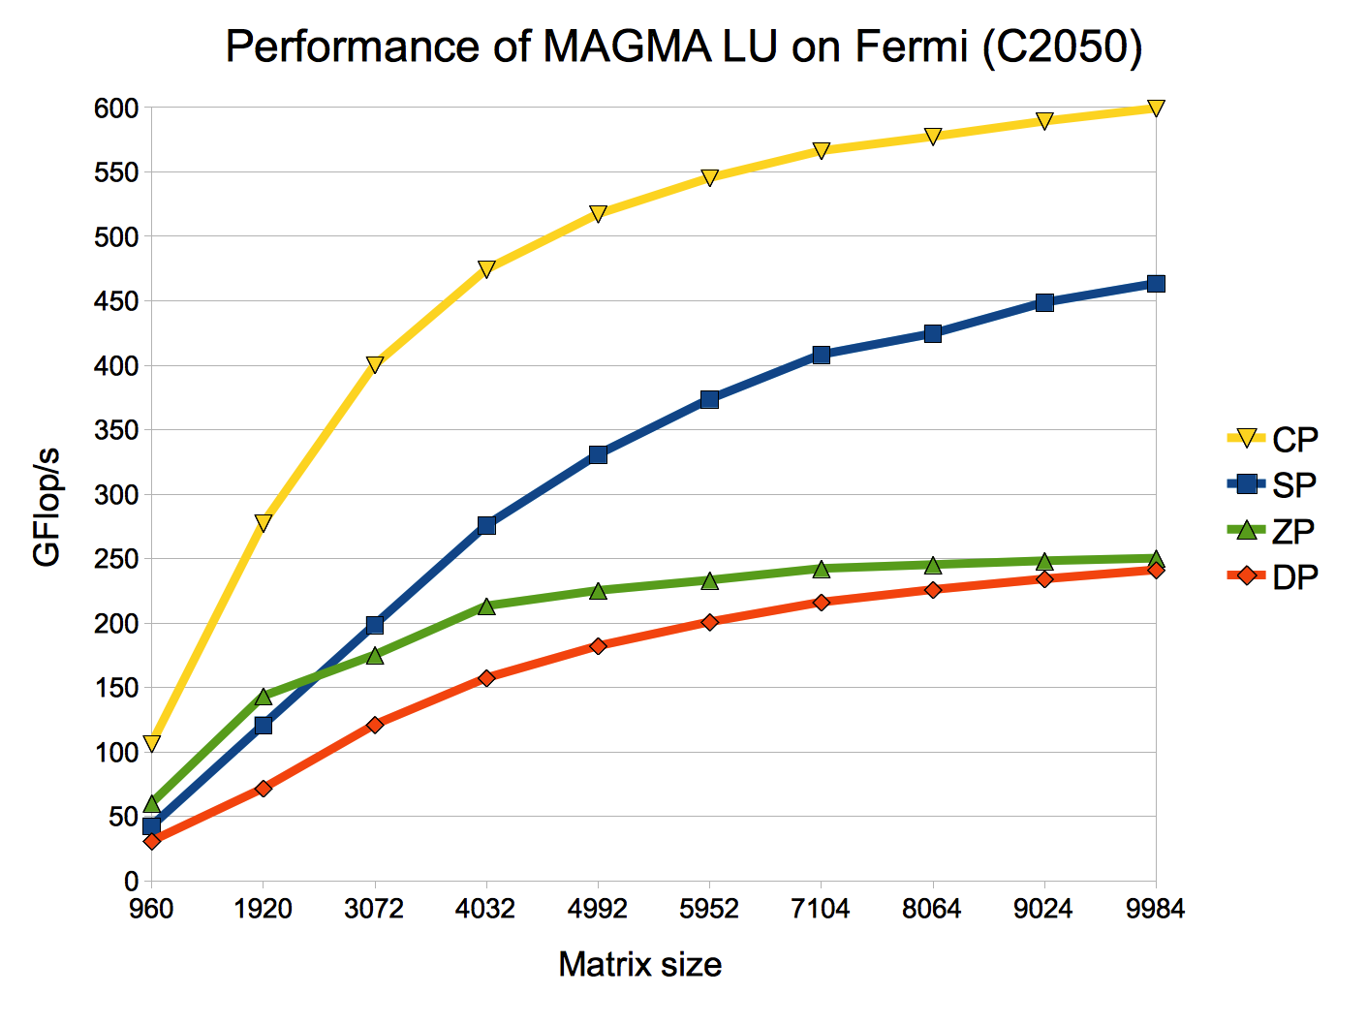

Slide 49
Mixed Precision Methods

Slide 50
Mixed Precision Methods
Mixed precision, use the lowest precision required to achieve a given accuracy outcome
  Improves runtime, reduce power consumption, lower data movement
  Reformulate to find correction to solution, rather than solution
  [ Δx rather than x ].

Slide 51
Idea Goes Something Like This…
Exploit 32 bit floating point as much as possible.
  Especially for the bulk of the computation
Correct or update the solution with selective use of 64 bit floating point to provide a refined results
Intuitively:
  Compute a 32 bit result,
  Calculate a correction to 32 bit result using selected higher precision and,
  Perform the update of the 32 bit results with the correction using high precision.

Slide 52
Mixed-Precision Iterative Refinement
Iterative refinement for dense systems, Ax = b, can work this way.
  Wilkinson, Moler, Stewart, & Higham provide error bound for SP fl pt results when using DP fl pt.
L U = lu(A) SINGLE O(n³)
x = L\(U\b) SINGLE O(n²)
r = b – Ax DOUBLE O(n²)
WHILE || r || not small enough
z = L\(U\r) SINGLE O(n²)
x = x + z DOUBLE O(n¹)
r = b – Ax DOUBLE O(n²)
END

Slide 53
Mixed-Precision Iterative Refinement
Iterative refinement for dense systems, Ax = b, can work this way.
  Wilkinson, Moler, Stewart, & Higham provide error bound for SP fl pt results when using DP fl pt.
  It can be shown that using this approach we can compute the solution to 64-bit floating point precision.
    Requires extra storage, total is 1.5 times normal;
    O(n³) work is done in lower precision
    O(n²) work is done in high precision
    Problems if the matrix is ill-conditioned in sp; O(10⁸)
L U = lu(A) SINGLE O(n³)
x = L\(U\b) SINGLE O(n²)
r = b – Ax DOUBLE O(n²)
WHILE || r || not small enough
z = L\(U\r) SINGLE O(n²)
x = x + z DOUBLE O(n¹)
r = b – Ax DOUBLE O(n²)
END

Slide 54
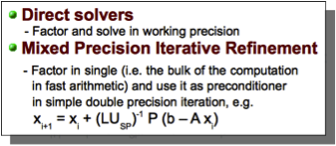
Results – linear solvers
MAGMA LU-based solvers on Fermi (C2050)
FERMI Tesla C2050: 448 CUDA cores @ 1.15GHz
SP/DP peak is 1030 / 515 GFlop/s
Similar results for Cholesky & QR

Slide 55
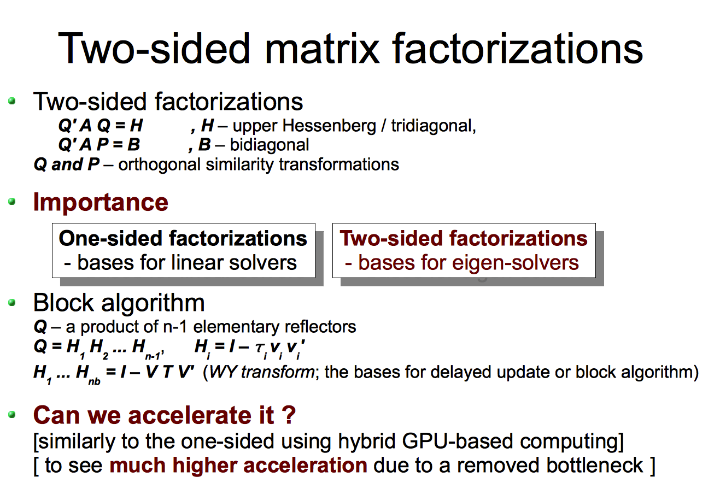

Slide 56
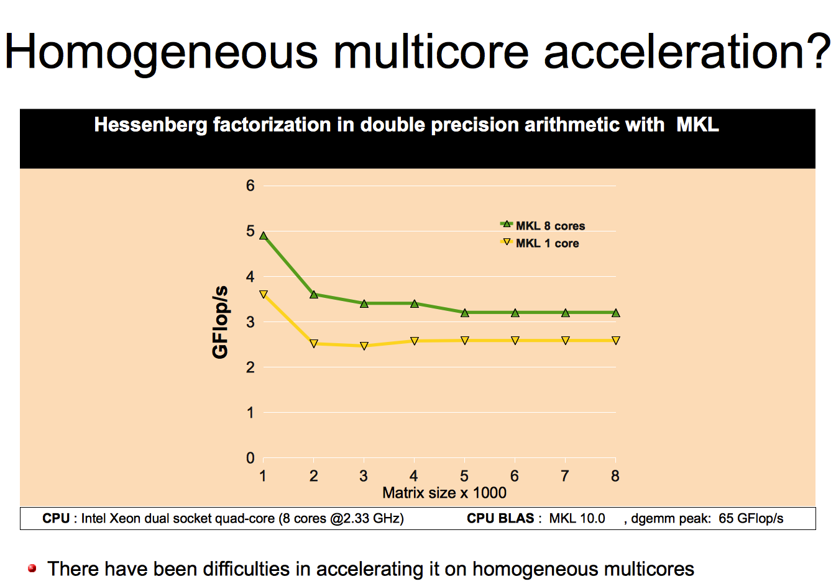

Slide 57
Two-sided matrix factorizations
Used in singular-value and eigen-value problems
LAPACK-based two-sided factorizations are rich in Level 2 BLAS and therefore can not be properly accelerated on multicore CPUs
We developed hybrid algorithms exploring GPUs' high bandwidth
High-performance CUDA kernels were developed
for various matrix-vector products
[ e.g., ssymv reaching up to 102 Gflop/s for the
symmetric eigenvalue problem ]
GPU: GTX280 (240 cores @ 1.30GHz, 141 GB/s)‏
CPU: 2 x 4 cores Intel Xeon @ 2.33GHz, 10.4 GB/s)‏

Slide 58
Statically Scheduled Two-Sided Factorizations
[ Hessenber, tridiagonal, and bidiagonal reductions ]
Hybridization
  Trailing matrix updates (Level 3 BLAS) are done on the GPU
  (similar to the one-sided factorizations)
  Panels (Level 2 BLAS) are hybrid
  – operations with memory footprint restricted to the panel are done on CPU
  – The time consuming matrix-vector products involving the entire trailing
  matrix are done on the GPU
Note
  CPU-to-GPU communications and subsequent computations always stay in surface-to-volume ratio

Slide 59
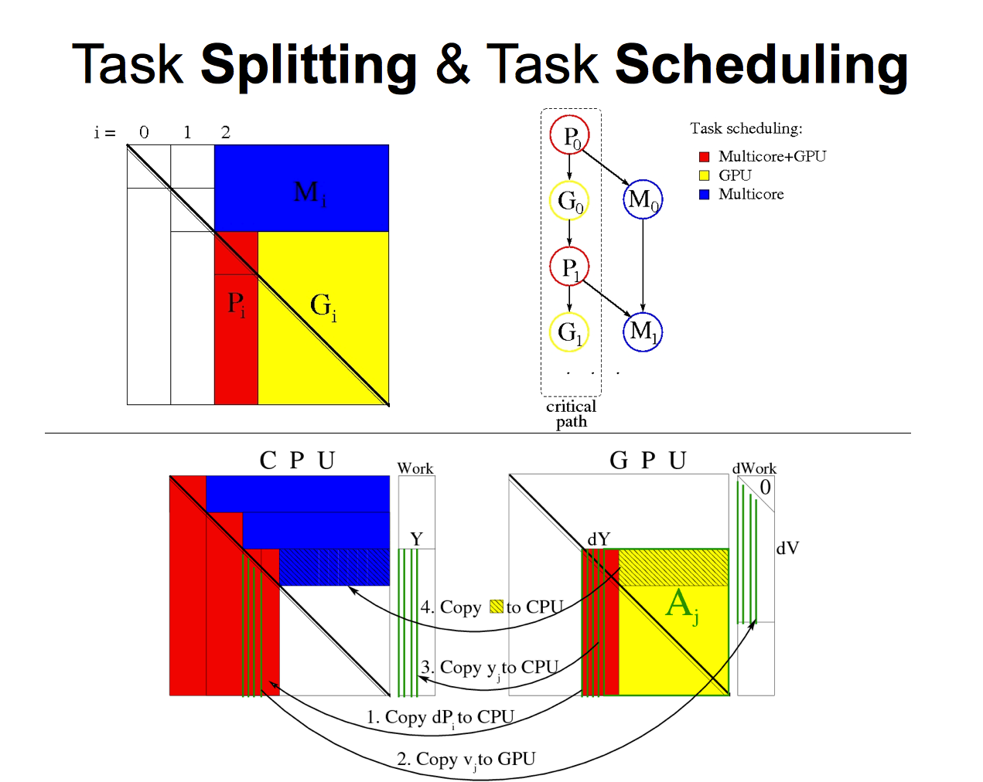

Slide 60
Results – two sided factorizations
Hessenberg Factorization in double precision
[ for the general eigenvalue problem ]
FERMI Tesla C2050: 448 CUDA cores @ 1.15GHz
SP/DP peak is 1030 / 515 Gflop/s
[ system cost ~ $3,000 ]
ISTANBUL AMD 8 socket 6 core (48 cores) @2.8GHz
SP/DP peak is 1075 / 538 Gflop/s
[ system cost ~ $30,000 ]
Similar accelerations for the
bidiagonal factorization [for SVD] &
tridiagonal factorization [for the
symmetric eigenvalue problem]
Similar acceleration (exceeding 10x)
compared to other top-of-the-line
multicore systems (including
Nehalem-based) and libraries
(including MKL, ACML)

Slide 61
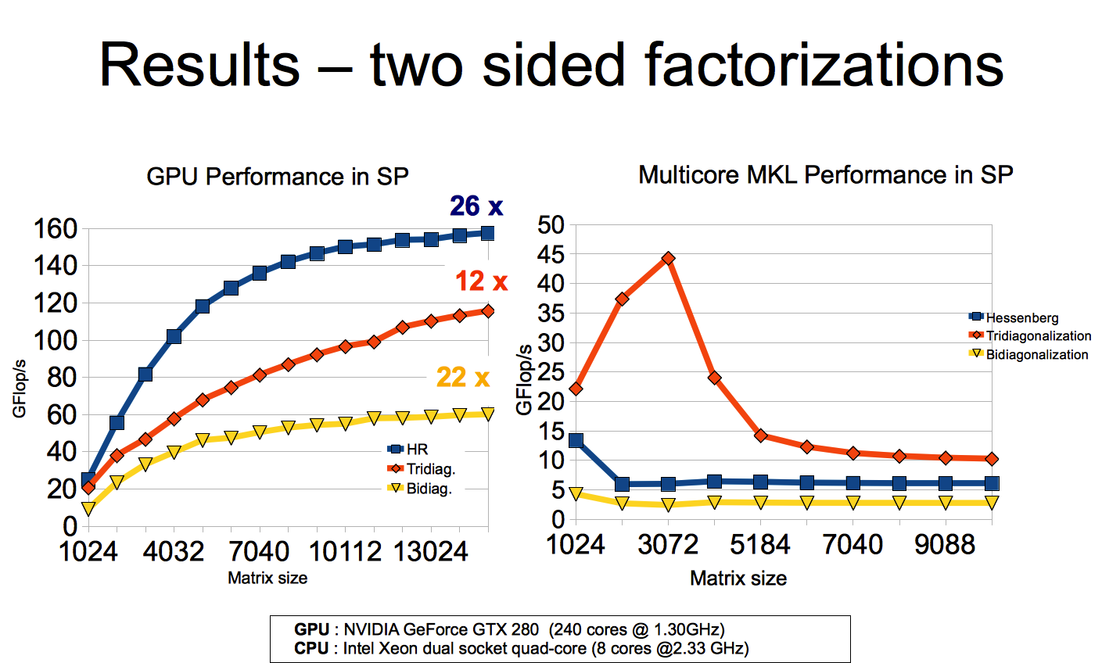

Slide 62
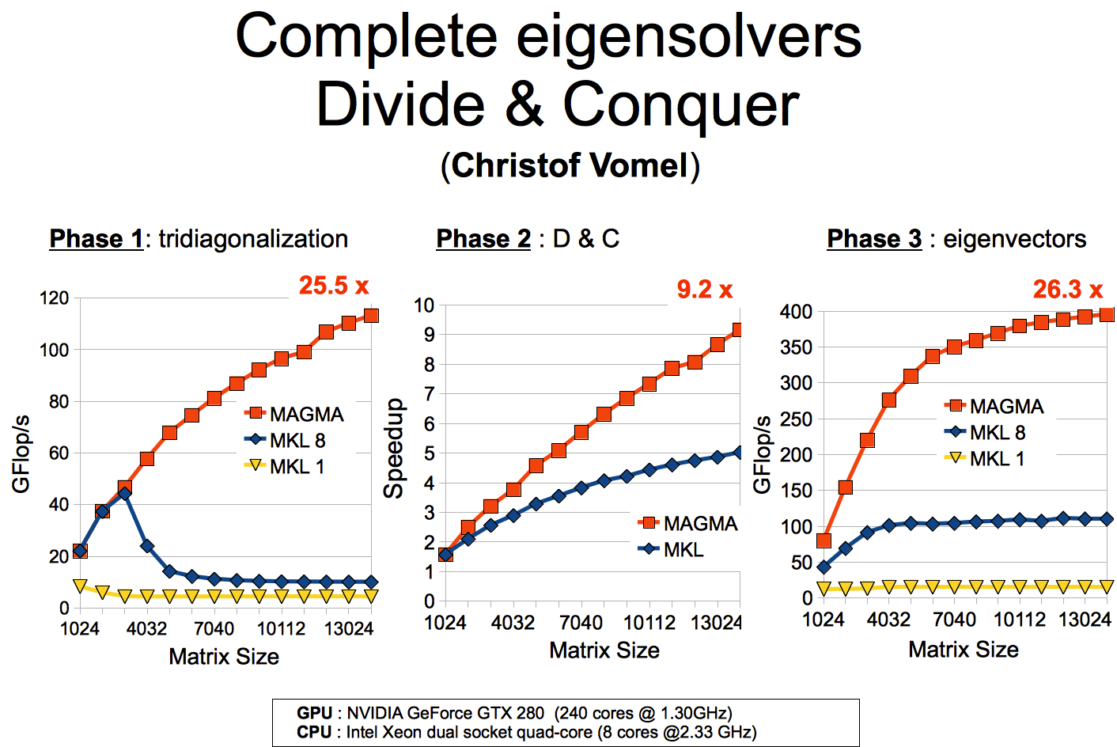

Slide 63
MAGMA BLAS

Slide 64
MAGMA BLAS
Performance critically depend on BLAS
How to develop fast CUDA BLAS?
GEMM and SYMV examples

Slide 65
GEMM for Fermi
SGEMM and M3 CGEMM
DGEMM and M3 ZGEMM
63% of peak
58% of peak
Tesla C2050 (Fermi): 448 CUDA cores @ 1.15GHz, theoretical SP peak is 1.03 Tflop/s, DP is 515 GFlop/s)
CUBLAS 3.2 GEMM are based on these kernels
TRSM and other Level 3 BLAS based on GEMM
Auto-tuning has become more important
- e.g., for BLAS, for higher-level hybrid algorithms, and for an OpenCL port

Slide 66
Autotuning

Slide 67
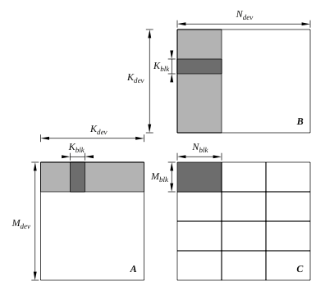
BACUGen – autotuning of GEMM
(J. Kurzak, UTK)
C = α A B + β C
Two levels of parallelism
  Grid of thread blocks
  [coarse-level data parallelism]
  Thread block
  [fine-level parallelism within
  a block]
Parameterized template to
generate many versions
  including shared memory
  and register blocking
Empirically find the “best” version
Top-level view of the algorithm

Slide 68
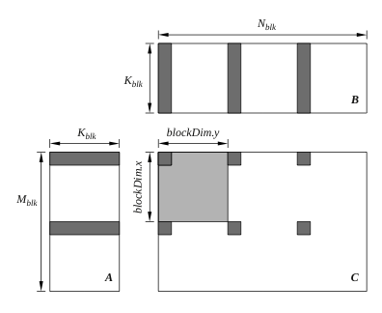
BACUGen – autotuning of GEMM
Parallelism in a thread block
[ blockDim.x x blockDim.y threads ]
A thread in this example computes
6 elements
Register blocking
  In this example:
  2 + 3 elements are loaded in
  registers (from shared memory)
  and reused in
  2 x 3 multiply-adds
Thread-level view of the algorithm

Slide 69
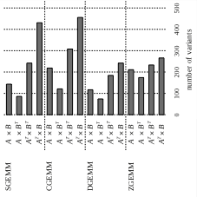
BACUGen – autotuning of GEMM
Number of variants
generated and tested

Slide 70
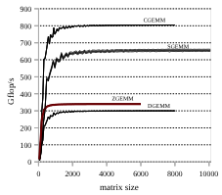
BACUGen – autotuning of GEMM
Performance on Fermi
(C2050) in Gflop/s
ZGEMM improved significantly
compared to CUBLAS
  from 308 to 341 Gflop/s
Improvement up to 2x on
some specific matrices
(e.g., of “rectangular” shape)

Slide 71
SYMV example
y = α A x + β y, where A is a symmetric matrix
Memory bound kernel
n² sizeof(data_type) B -> 2 n² flops
=> theoretical SSYMV peak on a 142 GB/s bus (e.g., in GTX280)
is 142 Gflop/s
“Irregular” data accesses
O(1) Gflop/s with CUBLAS
  What can be done?

Slide 72
SYMV example
Explore the symmetry
N² / NB work space
A
x
y
x₁
A’₃₁x₃
NB
A₃₁
x₃
A₃₁ x₁
=
+
+
+
+
+
=
1 2 3 4 5 6
1 2 3 4 5 6

Slide 73
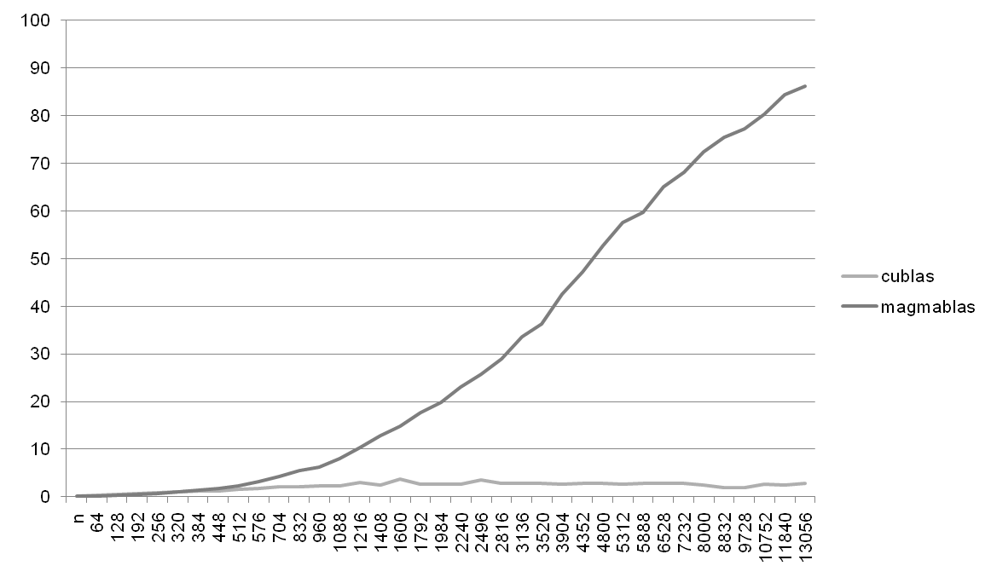
SYMV example
Performance of SSYMV on GTX280
Gflop/s
Matrix size

Slide 74
Multicore + multi-GPU algorithms

Slide 75
Multicore + multi-GPU algorithms
Reuse already developed kernels
  Hybrid MAGMA 1.0 for single GPU
  PLASMA for multticore
Use run time system to schedule (dynamically) the kernels’ execution
  StarPU
  QUARK (from PLASMA)
  …

Slide 76
The StarPU runtime system
The need for runtime systems
HPC Applications
do dynamically what would be difficult to do statically
Library that provides
  Task scheduling
  Memory management
Parallel
Compilers
Parallel Libraries
Runtime system
http://runtime.bordeaux.inria.fr/StarPU/
Operating System
CPU
GPU
…

Slide 77
Productivity
Develop parallel multicore + multiGPU algorithms from
sequential algorithms
Example to be given w/ QUARK scheduler (in PART II)
// Sequential Tile Cholesky
FOR k = 0..TILES-1
DPOTRF(A[k][k])
FOR m = k+1..TILES-1
DTRSM(A[k][k], A[m][k])
FOR n = k+1..TILES-1
DSYRK(A[n][k], A[n][n])
FOR m = n+1..TILES-1
DGEMM(A[m][k], A[n][k], A[m][n])
// Hybrid Tile Cholesky
FOR k = 0..TILES-1
starpu_Insert_Task(DPOTRF, …)
FOR m = k+1..TILES-1
starpu_Insert_Task(DTRSM, …)
FOR n = k+1..TILES-1
starpu_Insert_Task(DSYRK, …)
FOR m = n+1..TILES-1
starpu_Insert_Task(DGEMM, …)

Slide 78
Performance scalability
Statistics for codelet spotrf
CUDA 0 (Quadro FX 5800) -> 3 / 36 (8.33 %)‏
CUDA 1 (Quadro FX 5800) -> 1 / 36 (2.78 %)‏
CUDA 2 (Quadro FX 5800) -> 3 / 36 (8.33 %)‏
CPU 0 -> 6 / 36 (16.67 %)‏
CPU 1 -> 9 / 36 (25.00 %)‏
CPU 2 -> 4 / 36 (11.11 %)‏
CPU 3 -> 6 / 36 (16.67 %)‏
CPU 4 -> 4 / 36 (11.11 %)‏
Statistics for codelet ssyrk
CUDA 0 (Quadro FX 5800) -> 41 / 630 (6.51 %)‏
CUDA 1 (Quadro FX 5800) -> 40 / 630 (6.35 %)‏
CUDA 2 (Quadro FX 5800) -> 49 / 630 (7.78 %)‏
CPU 0 -> 105 / 630 (16.67 %)‏
CPU 1 -> 85 / 630 (13.49 %)‏
CPU 2 -> 105 / 630 (16.67 %)‏
CPU 3 -> 102 / 630 (16.19 %)‏
CPU 4 -> 103 / 630 (16.35 %)‏
Statistics for codelet strsm
CUDA 0 (Quadro FX 5800) -> 125 / 630 (19.84 %)‏
CUDA 1 (Quadro FX 5800) -> 127 / 630 (20.16 %)‏
CUDA 2 (Quadro FX 5800) -> 122 / 630 (19.37 %)‏
CPU 0 -> 50 / 630 (7.94 %)‏
CPU 1 -> 52 / 630 (8.25 %)‏
CPU 2 -> 52 / 630 (8.25 %)‏
CPU 3 -> 54 / 630 (8.57 %)‏
CPU 4 -> 48 / 630 (7.62 %)‏
Statistics for codelet sgemm
CUDA 0 (Quadro FX 5800) -> 2258 / 7140 (31.62 %)‏
CUDA 1 (Quadro FX 5800) -> 2182 / 7140 (30.56 %)‏
CUDA 2 (Quadro FX 5800) -> 2261 / 7140 (31.67 %)‏
CPU 0 -> 87 / 7140 (1.22 %)‏
CPU 1 -> 94 / 7140 (1.32 %)‏
CPU 2 -> 85 / 7140 (1.19 %)‏
CPU 3 -> 85 / 7140 (1.19 %)‏
CPU 4 -> 88 / 7140 (1.23 %)‏
Performance of Cholesky factorization in SP
SGEMM
gpu : 333.04 GFlop/s
cpu : 20.06 GFlop/s
STRSM
gpu : 59.46 GFlop/s
cpu : 18.96 GFlop/s
SSYRK
gpu : 298.74 GFlop/s
cpu : 19.50 GFlop/s
SPOTRF
gpu : 57.51 GFlop/s
cpu : 17.45 GFlop/s
  5 CPUs (Nehalem) + 3 GPUs (FX5800)
  Efficiency > 100%

Slide 79
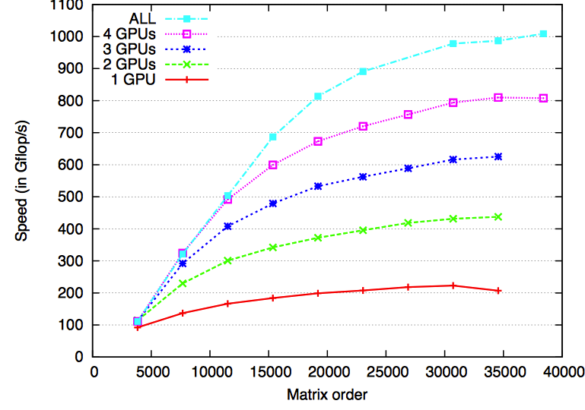
PLASMA & MAGMA with StarPU
QR factorization
  System: 16 CPUs (AMD) + 4 GPUs (C1060)

Slide 80
Scheduling using QUARK
Register tasks & dependencies in
QUARK (similar to StarPU)
Need a layer/mechanism to handle
CPU-GPU communications
Use MAGMA and LAPACK/ScaLAPACK

Slide 81
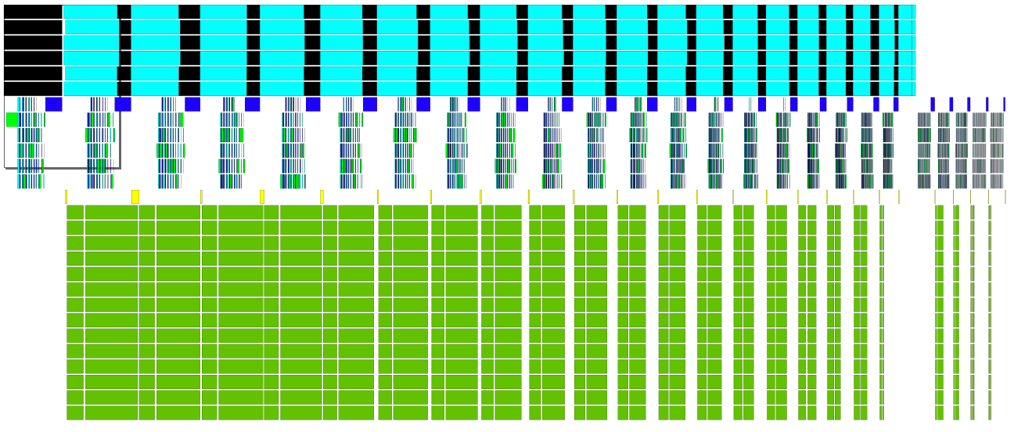
A QR for GPU + Multicore
Parallel, dynamically scheduled panel factorizations (w/ QUARK) on multicore
Parallel updates on multicore
Parallel updates on GPU
Hybrid QR factorization trace for matrix of size 3360 x 3360

Slide 82
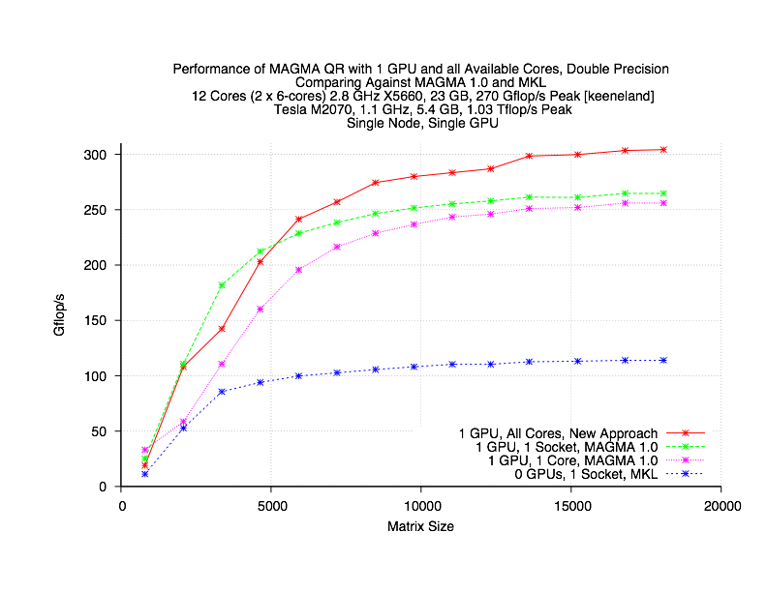
A QR for GPU + Multicore

Slide 83
Current and future work

Slide 84
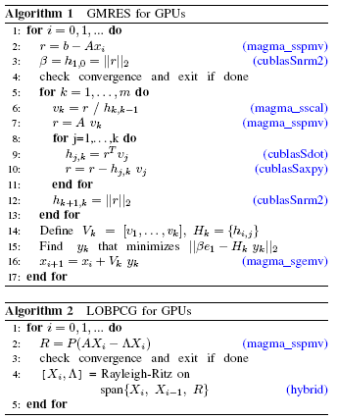
Sparse iterative solvers
The hybridization approach naturally works
[e.g., Richardson iteration in mixed-precision
iterative refinement solvers, Krylov space
iterative solvers and eigen-solvers ]
Fast sparse matrix-vector product on Fermi
Explore ideas to reduce communication
[ e.g., mixed precision, reduced storage for integers for the indexing, etc. ]
Need high bandwidth

Slide 85
Current and future work
Hybrid algorithms
  Further expend functionality
  New highly parallel algorithms of optimized communication and synchronization
OpenCL support
  To be derived from OpenCL BLAS
Autotuning framework
  On both high level algorithms & BLAS
Multi-GPU algorithms
  StarPU scheduling

Slide 86
DPLASMA (Work in progress)
Provide a framework for distributed execution of a DAG
  Taking in account the properties of the hardware and the network (cores and accelerators)
  Minimizing the impact on the system (CPU and memory waste)
Let the user describe the algorithms based on data dependencies between tasks
  Language to be defined

Slide 87
DPLASMA
Distribute the DAG analysis
  The DAG is never completely unrolled
  Each node only unrolls it’s own portion of the DAG
Minimize the data transfers
Overlap communication and computations
Many possible extensions on the scheduling

Slide 88
Conclusions
Linear and eigenvalue solvers can be significantly accelerated on systems of multicore and GPU architectures
Many-core architectures with accelerators (e.g., GPUs) are the future of high performance scientific computing
Challenge: Fundamental libraries will need to be redesigned/rewritten to take advantage of the emerging
many-core architectures

Slide 89







Collaborators / Support
MAGMA [Matrix Algebra on GPU
and Multicore Architectures] team
http://icl.cs.utk.edu/magma/
PLASMA [Parallel Linear Algebra
for Scalable Multicore
Architectures] team
http://icl.cs.utk.edu/plasma
Collaborating partners
University of Tennessee, Knoxville
University of California, Berkeley
University of Colorado, Denver
INRIA, France
KAUST, Saudi Arabia

