Slide 1

Presented by: Dr. Lynne Parker, Director
April 1, 2011

Slide 2
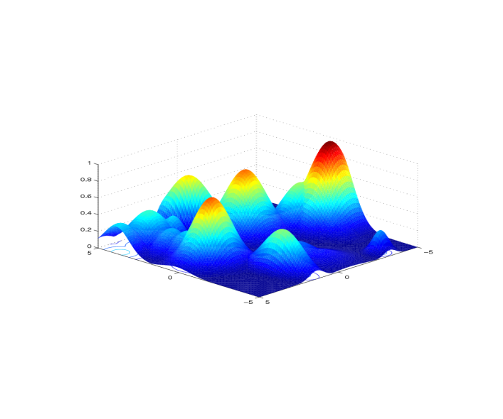
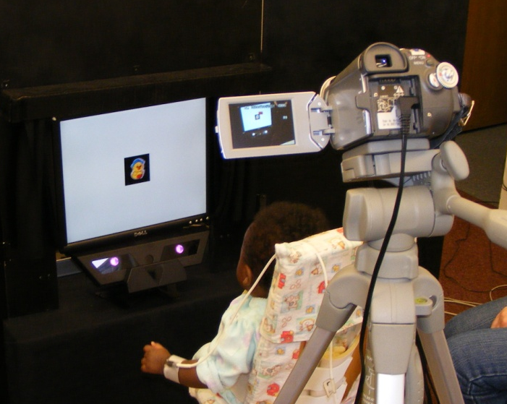
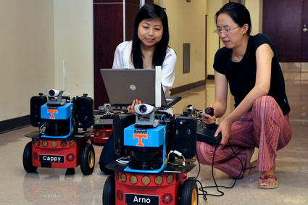
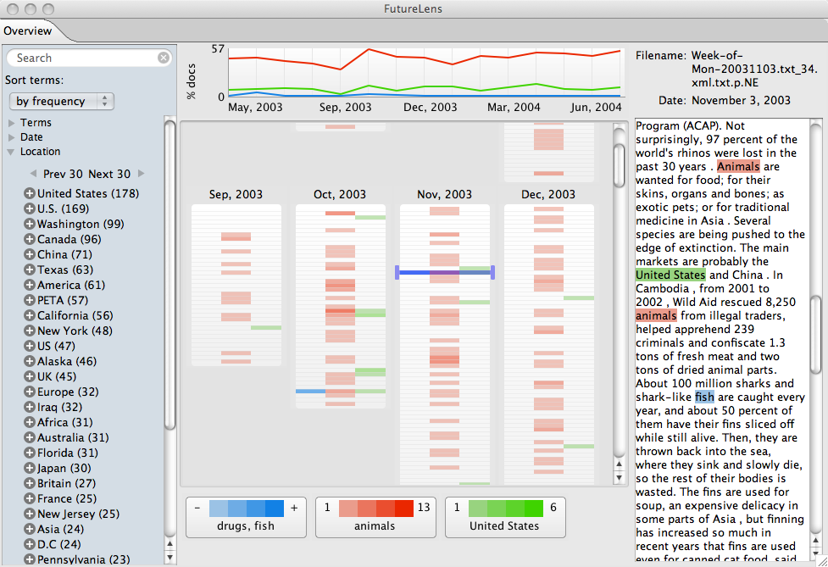
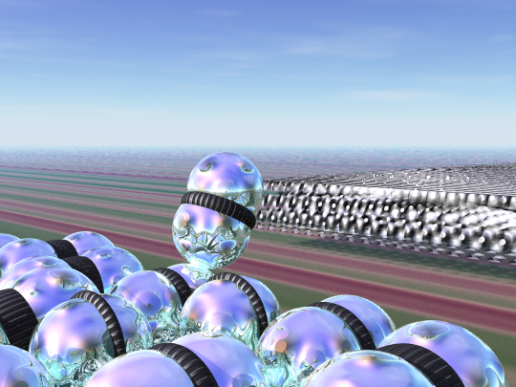
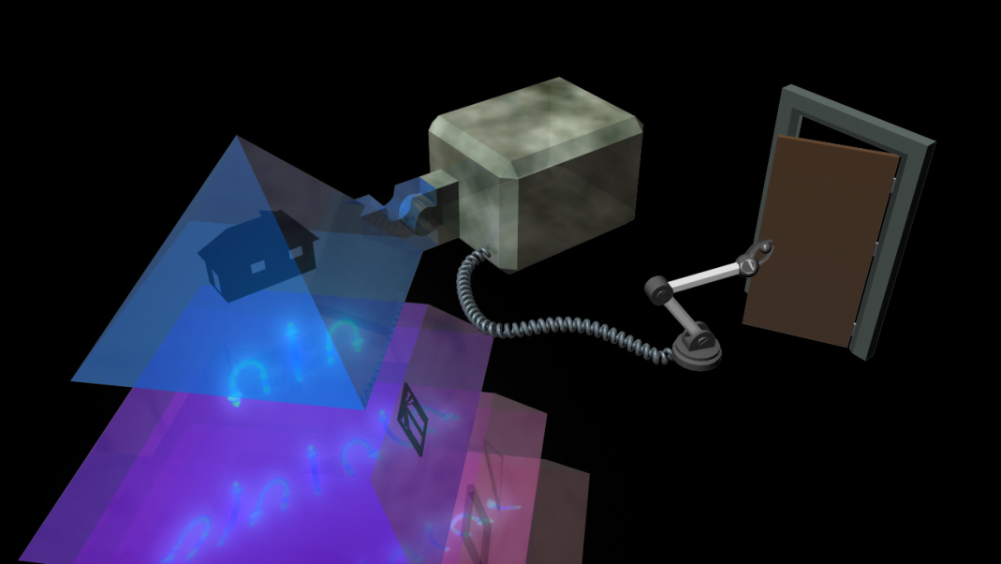
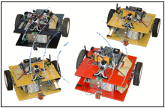
The Vision for CISML
Develop interdisciplinary theory and practice of intelligent systems and machine learning technologies
Enable cross-fertilization of ideas from several individual disciplines
Attract increased external funding involving multiple faculty
Help UTK reach its Top 25 goal, by cultivating our established strengths in intelligent systems and machine learning
Attract more highly qualified students
Integrate curricular content and emphasize interdisciplinary study

Slide 3
Who is our “competition”?
Carnegie Mellon University, Machine Learning Department
24 core faculty, 27 affiliated faculty, ~20 related faculty
Highly interdisciplinary
UC Berkeley, Center for Intelligent Systems
26 faculty & research staff
Highly interdisciplinary
UC Irvine, Center for Machine Learning and Intelligent Systems
30 faculty & research staff
Highly interdisciplinary
George Washington Univ., Center for Intelligent Systems Research
12 faculty & research staff
Emphasis is on Intelligent Transportation Systems
Vanderbilt, Center for Intelligent Systems
7 faculty & research staff
Emphasis is on robotics
University of Idaho, Center for Intelligent Systems Research
6 faculty and research staff
Emphasis is primarily control
By joining efforts, UTK’s CISML can become
a highly competitive research center

Slide 4
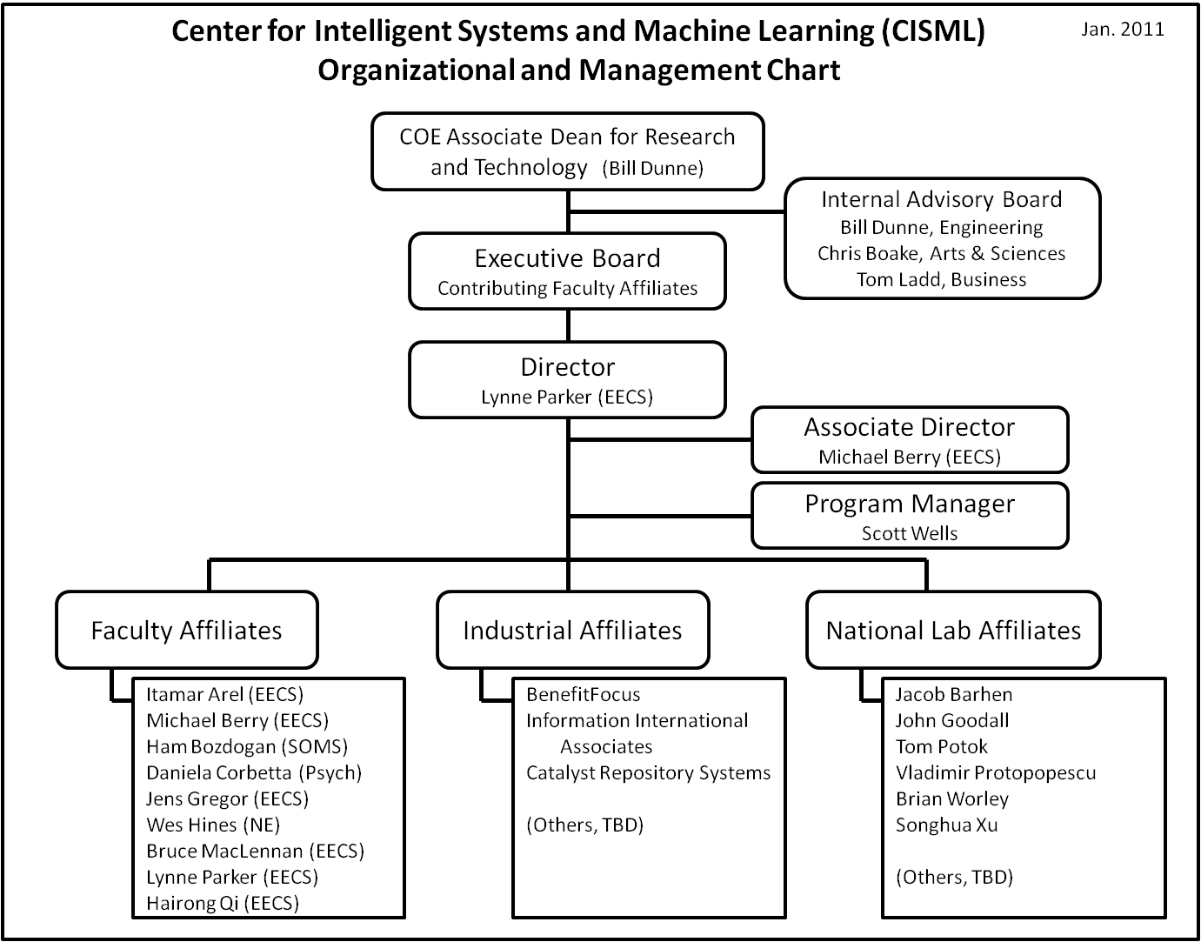
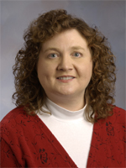
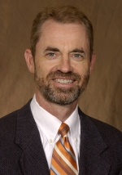
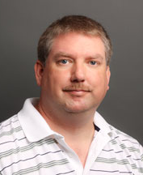
CISML Organization
Dr. Lynne Parker
CISML Director
Dr. Michael Berry
CISML Assoc. Director
Mr. Scott Wells
CISML Program Manager
Approved as formal UTK Center October, 2011

Slide 5
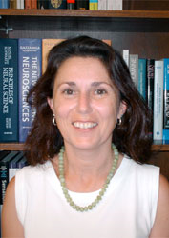
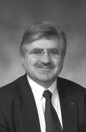
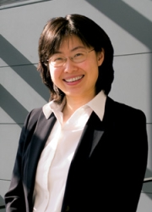
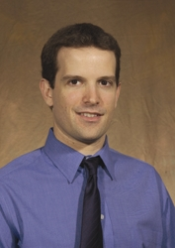
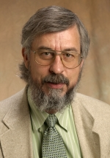
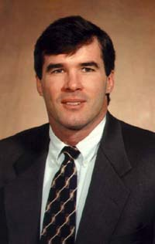
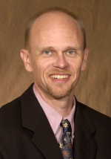
CISML UTK Faculty – From 3 Colleges, 4 Depts.
College of Arts and Sciences
Dr. Daniela Corbetta, Psychology
College of Engineering:
CISML Director: Dr. Lynne Parker, Electrical Engineering and Computer Science (EECS)
Dr. Itamar Arel, EECS
Dr. Michael Berry, EECS
Dr. Jens Gregor, EECS
Dr. J. Wes Hines, Nuclear Engineering
Dr. Bruce MacLennan, EECS
Dr. Hairong Qi, EECS
College of Business Administration
Dr. Ham Bozdogan, Statistics, Operations, and Mgmt. Sci.

Slide 6

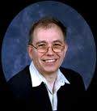

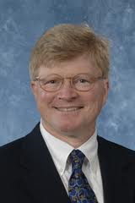
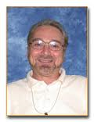
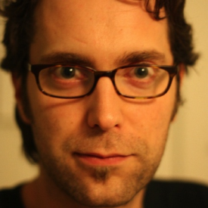
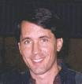
CISML Nat’l Lab Affiliates – from 2 Divisions, 4 groups
Computer Science and Mathematics Division:
Dr. Jacob Barhen, Complex Systems Group
Dr. Tom Potok, Applied Software Engineering Group
Computational Science and Engineering Division
Dr. Brian Worley, CSE Director
Dr. Vladimir Protopopescu, CSE Chief Scientist
Dr. John Goodall, Cyber Security and Information Infrastructure Research Group
Dr. Songhua Xu, Early Career Biomedical Research

Slide 7



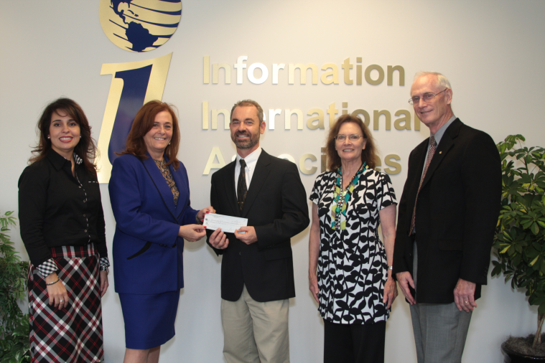
CISML Industrial Affiliates
Each industrial affiliate provides annual financial contributions
In return, their benefits are:
Access to undergrad and grad students for internships, employment
Collaborative research with CISML
Access to all public domain software developed, with opportunities for licensing
Access to faculty and student research publications
Display of corporate logo on website
Participation in Industrial Affiliate workshop
Recognition as CISML Industrial Affiliate
More industrial affiliates being recruited …

Slide 8
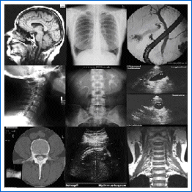
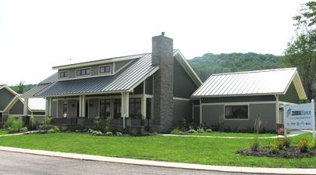
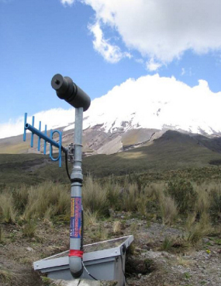

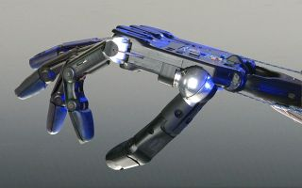
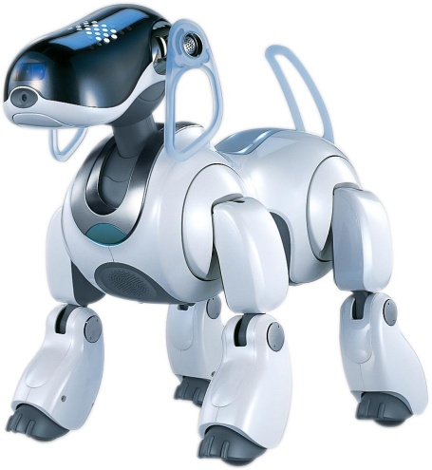
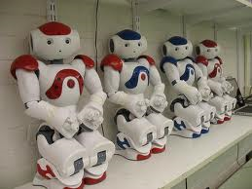
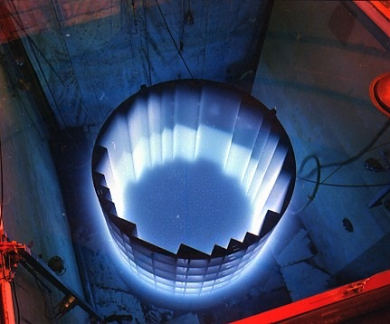
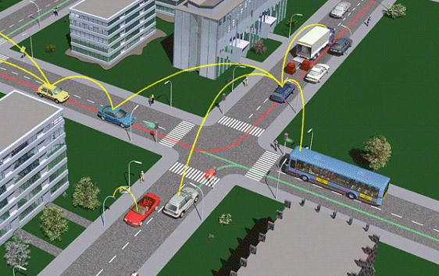
Opportunities are Numerous and Significant: Many potential applications → Many funding sponsors
Example applications:
Energy applications
E.g., Building energy prediction
Environmental monitoring
E.g., prediction of volcanic eruptions
Medical diagnosis
E.g., Breast cancer detection, diagnostic imaging, detection of cause of heart attack
Text and data mining
E.g., Email/blog surveillance
Cognitive computing and robotic learning
E.g., Using infant perceptual-motor learning
Reliability and prognostics
E.g., in nuclear reactors, multi-robot systems
Intelligent transportation systems
E.g., automatic detection of incidents, maximizing flow

Slide 9

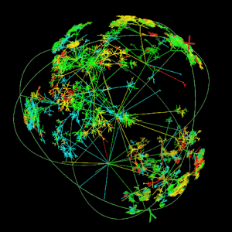
Opportunities are Numerous and Significant: Many potential applications → Many funding sponsors
NSF’s current/recent relevant programs
Emerging Frontiers in Research and Innovation (EFRI):
2011 topic: Mind, Machines, and Motor Control (M3C)
Robust Intelligence: computational understanding and modeling of intelligence in complex, realistic contexts
Cyber-Enabled Discovery and Innovation: create revolutionary science and engineering research outcomes via innovations and advances in computational thinking
Cyber-Physical Systems: systems that tightly conjoin and coordinate computational and physical resources
(and more…)

Slide 10
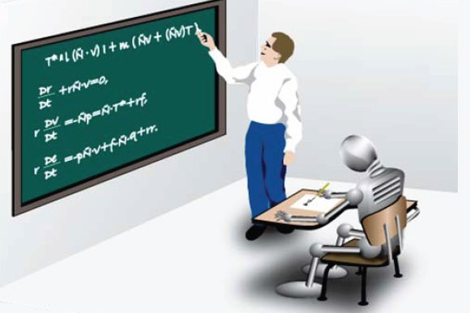
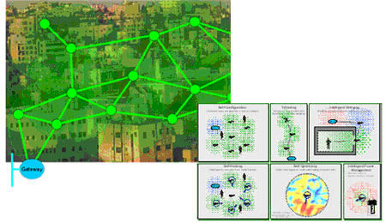
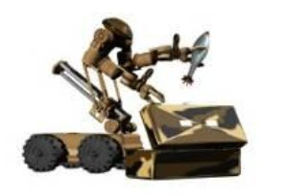
External Funding Opportunities (con’t.)
DARPA’s recent relevant programs:
Bootstrapped Learning: automated system learns from human teacher
Integrated Learning: automated system opportunistically assembles knowledge from many sources in order to learn
LANdroids: intelligent autonomous radio relay nodes
Machine Reading: text engine that captures knowledge from text
Personalized Assistant that Learns: cognitive systems that act as assistants
Transfer Learning: reusing knowledge derived in one domain to solve problems in other domains
Persistent Operational Surface Surveillance and Engagement: integrated suite of heterogeneous sensors that can perform pattern analysis to extract early warnings of certain activities

Slide 11
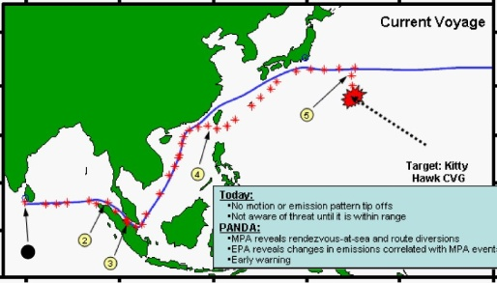

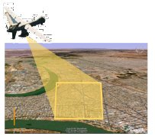
External Funding Opportunities (con’t).
DARPA’s recent relevant programs (con’t.)
Predictive Analysis for Naval Deployment Activities: automated detection of anomalous ship behavior
Physical Intelligence: develop physically-grounded understanding of intelligence for engineered systems and scales to high levels of organization
NEOVISION2: revolutionize unmanned sensor systems by emulating the mammalian visual pathway using advanced modeling and algorithms
Deep Learning: universal machine learning engine that uses a single set of methods in multiple layers to generate progressively more sophisticated representations of patterns, invariants, and correlations from data
PerSEAS: automatic and interactive discovery of actionable intelligence from wide area motion imagery of urban, surburban, and rural environments
Mind’s Eye: visual intelligence in machines
(and more…)

Slide 12










External Funding Opportunities (con’t).
Other important sponsors with broad open BAAs relevant to CISML include NIH, DOE, ONR, ARO, AFOSR, IARPA, etc.
Other Industries currently engaged with CISML faculty (but not yet Affiliates) include: Pilot Travel Centers, Voices Heard Media, Computable Genomix, SAS, M-CAM, and Lockheed Martin Advanced Technology Laboratories

Slide 13
Key Objective of CISML: Leverage Research Synergies to Pursue Multi-Collaborator Funding
Strategy:
Identify unique synergies amongst CISML Faculty, National Lab, and Industrial Affiliates
Through extensive discussions, CISML seminars, cross-fertilization of ideas
Leverage synergies to pursue new directions for multi-collaborator, multi-disciplinary research
Explore and pursue opportunities to participate in UTK, State, and National Initiatives
E.g., in Energy/Power, national security and non-proliferation, manufacturing, etc.
Explore and pursue opportunities for Center-level funding
E.g., with NSF, DOE, etc.

Slide 14
Building CISML Synergies from Existing Competencies
CISML Affiliates have broad expertise in Intelligent Systems and Machine Learning:
Reinforcement learning, deep machine learning (Arel, Parker)
Text/data mining and knowledge discovery (Berry, Bozdogan, Goodall, Parker, Potok, Xu, Worley)
Human infant perceptual and motor learning (Corbetta)
Cognitive learning (Arel, Corbetta)
Pattern recognition (Barhen, Berry, Gregor, Hines, Parker, Qi)
Computing imaging (Gregor)
Prognostics and diagnostics (Hines, Parker)
Embodied intelligence (Arel, Corbetta, MacLennan, Parker)
Collaborative/Cooperative/Distributed systems (Parker, Potok, Protopopescu, Qi)
Remote sensing (Barhen, Parker)
Biologically-inspired intelligence (Arel, MacLeannan, Parker, Potok)

Slide 15
Machine Intelligence Lab – Dr. Itamar Arel
Founded: August 2004
Location: SERF 213 and SERF 204
Director: Dr. Itamar Arel, EECS Department
Currently hosts 8 graduate research students, and 3 undergrad research assistants
Areas of research focus:
Reinforcement learning in artificial intelligence
Deep-layer machine learning
Biologically-inspired cognitive architectures
Intelligent transportation systems
Sponsors: DOE, NSF, ORNL, NTRCI, Altera, Science Alliance
http://mil.engr.utk.edu

Slide 16



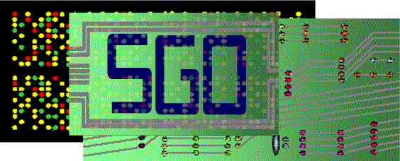
Text Mining/Knowledge Discovery – Dr. Michael Berry
Text mining and knowledge discovery using nonnegative matrix and tensor factorization in bioinformatics, scenario/plot analysis, email/blog surveillance, and environments supporting visual analytics; founded Computable Genomix, LLC in 2007

Slide 17
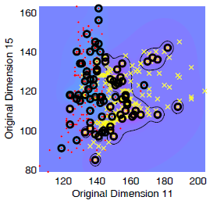
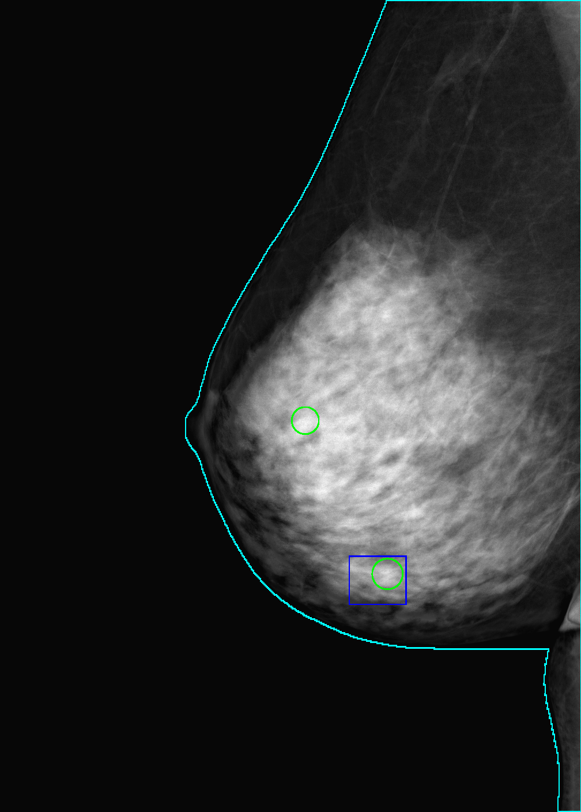
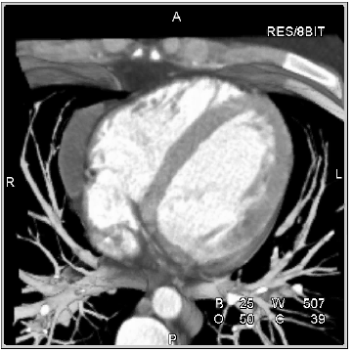
Statistics Micro-Computing Laboratory (SMCL) – Dr. Ham Bozdogan
SMCL Research
Founded: Spring 1996
Location: SMC, College of Business
Director: Ham Bozdogan
Research Focus: Develop new and novel tools for model selection and information complexity criteria, model-based clustering and classification with applications to detection of breast cancer, early detection of the cause of heart attack, fraud detection, portfolio modeling. Multivariate statistical modeling and data mining in high dimensions. Kernel-based methods in machine learning. Bayesian and econometric modeling. Interactive symbolic statistical computing.
Research Funding: Pending from U.S. Dept. of Energy on Social Networking in Scientific Collaboration.
High Dimensional Data Mining
Detection of breast cancer
Detection of cause of heart attack

Slide 18
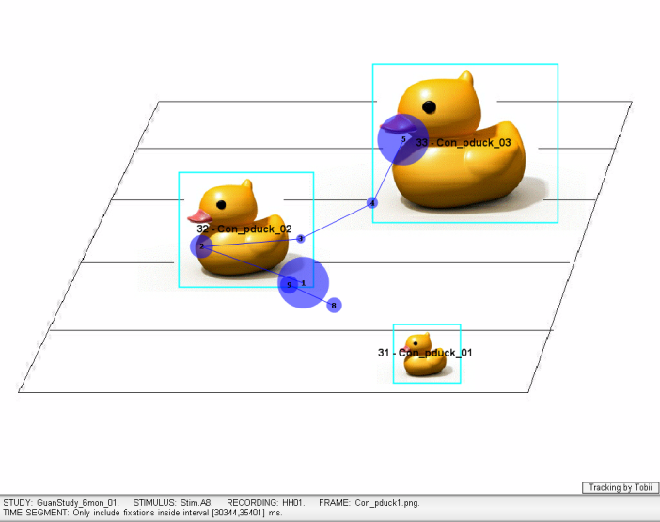
Infant Perception-Action Lab – Dr. Daniela Corbetta
The Infant Perception-Action Laboratory:
Founded: August, 2005
Location: Psychology, College of Arts and Sciences
Director: Associate Prof. Daniela Corbetta
Research Focus: Perceptual-motor learning, perception-action mapping, embodied cognition in early development
Perceptual-motor mapping: the process by which young infants learn to integrate the perception of their body and information from the surrounding world to direct their attention and develop fundamental motor actions such as reaching for objects and walking. Eye-tracking and motion analysis are used to assess perceptual-motor mapping and its change over time.
Sponsors:
NSF, NIH/NICHD
http://web.utk.edu/~infntlab/
18

Slide 19
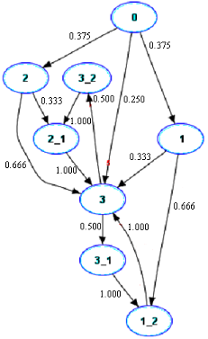

Pattern Recognition & Computed Imaging
– Dr. Jens Gregor
Background: Joined UT/CS in 1991. Professor since 2005.
Research focus: Pattern recognition and computed imaging.
Students advised/current: 4 BS, 22 MS, 4 PhD / 2 MS, 2 PhD.
Project examples: Preclinical diagnostic imaging of amyloidosis, Malicious mobile code fingerprinting, Low-level radioactive waste assay using computer tomography, X-ray CT image reconstruction from limited views.
Sponsors: National Institutes of Health, Office of Naval Research, Lockheed Martin Energy Systems, Oak Ridge National Laboratory.

Slide 20
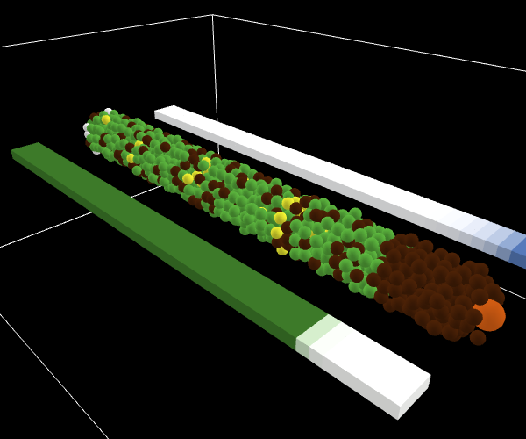
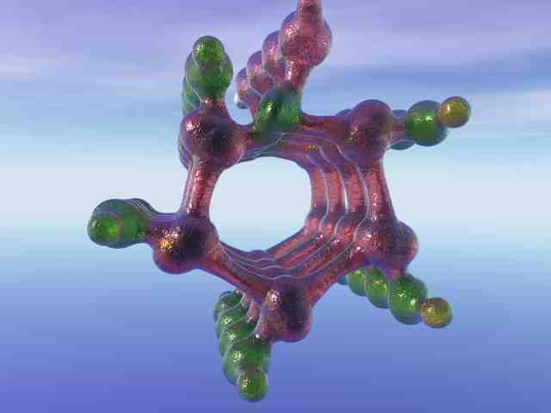

Emergent Computation Project – Dr. Bruce MacLennan
Emergent Computation: information processing and control emerge through interaction of large numbers of simple agents.
Focus: basic science and applications of
adaptive and self-organizing multi-agent systems
embodied intelligence and information processing
biologically-inspired artificial intelligence
Projects:
artificial morphogenesis
molecular computation
algorithmic assembly of nanostructures
International Journal of Nanotechnology and Molecular Computation
PI: Assoc. Prof. Bruce MacLennan (EECS)
http://www.cs.utk.edu/~mclennan/EC

Slide 21
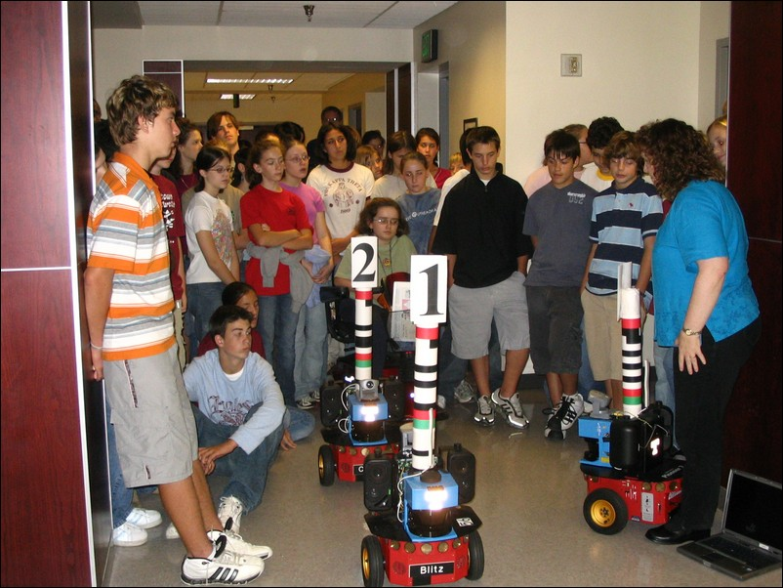
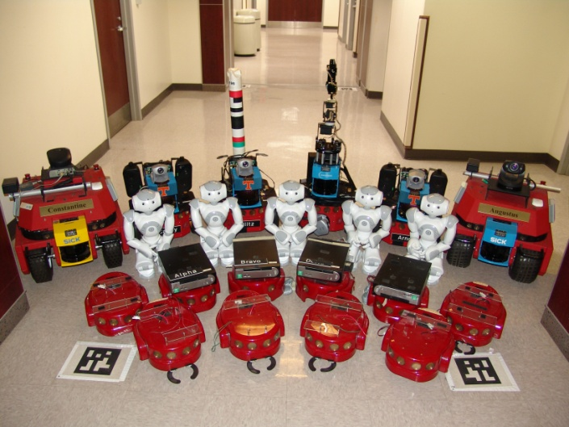
Distributed Intelligence Lab – Dr. Lynne Parker
The Distributed Intelligence Laboratory:
Founded: August, 2002
Location: Electrical Engr. and Computer Science, College of Engineering
Director: Prof. Lynne E. Parker
Research Focus: Distributed robotics, machine learning, and artificial intelligence
Distributed intelligent systems: multiple agents/robots that integrate perception, reasoning, and action to perform cooperative tasks under circumstances that are insufficiently known in advance, and dynamically changing during task execution.
Sponsors:
NSF, DARPA, SAIC, ORNL, Intel, Lockheed Martin, DOE, NASA/JPL, Georgia Tech, Univ. of North Carolina
http://www.cs.utk.edu/dilab

Slide 22

Advanced Imaging and Collaborative Information Processing Laboratory – Dr. Hairong Qi
AICIP Research
Founded: August 2000
Location: EECS, College of Engineering
Director: Hairong Qi
Research Focus: Develop energy-efficient collaborative processing algorithms with fault tolerance in resource-constraint distributed environments
Resource-constraint distributed environments: A network of small-size, low-cost, smart sensor nodes (e.g., camera) with on-board processing, wireless communication, and self-powering capabilities, that when collaborate, can compensate for each other’s limited sensing, processing, and communication ability, perform high-fidelity situational awareness tasks, like event detection, recognition, correlation, etc.
Sponsors: NSF, DARPA, ONR, US Army, Air Force

Slide 23
What are CISML Research Synergies?
Identified thus far:
Using psychological studies of human infants’ manipulation learning to inform how to build smarter robotic systems
CISML Affiliates Involved: Arel, Corbetta, MacLennan, Parker
Led to pre-proposal submission to NSF’s EFRI program ($1.9M/4 years)
NSF invited us to submit full proposal (submitted April 1)
Using models of visual attention built from human infant studies to develop high-performing computational models
CISML Affiliates Involved: Arel, Corbetta
Preliminary research underway
Using statistical modeling for epidemiology analysis
CISML Affiliates Involved: Berry, Bozdogan, Information International Associates
Navy SBIR proposal submitted
Using spatio-temporal analysis to develop geographic information system tools
CISML Affiliates Involved: Berry, Information International Associates
Navy SBIR proposal submitted
Using novel technologies for improving the search of relevant online literature based on the segmentation of image, text, and audio data
CISML Affiliates Involved: Berry, Xu
Preliminary research underway
High Priority: Continue to define synergistic opportunities

Slide 24
Additional Year 1 CISML Accomplishments
Hired (1/1/11) CISML Program Manager – Scott Wells
Responsibilities:
Program development activities (identifying opportunities, coordination, writing, editing, submission, reporting)
Industrial outreach and fundraising
Strategic planning
Marketing and outreach (including handouts, newsletter, annual report, press releases)
Daily management of CISML (including reporting, overseeing budget and expenditures, etc.)
Developing and maintaining CISML website
Organizing bi-weekly seminar series
Development and maintenance of CISML ByLaws
Accountable for space and equipment management
Mr. Scott Wells
CISML Program Manager
Ph.D. candidate in communication and information (UTK)
M.S., Info. Sci, UTK
B.A., English (emphasis on technical and professional writing)
13+ years at UTK Center for Info. Tech. Research (CITR) , as Assistant Director, Program Director, Research Associate

Slide 25
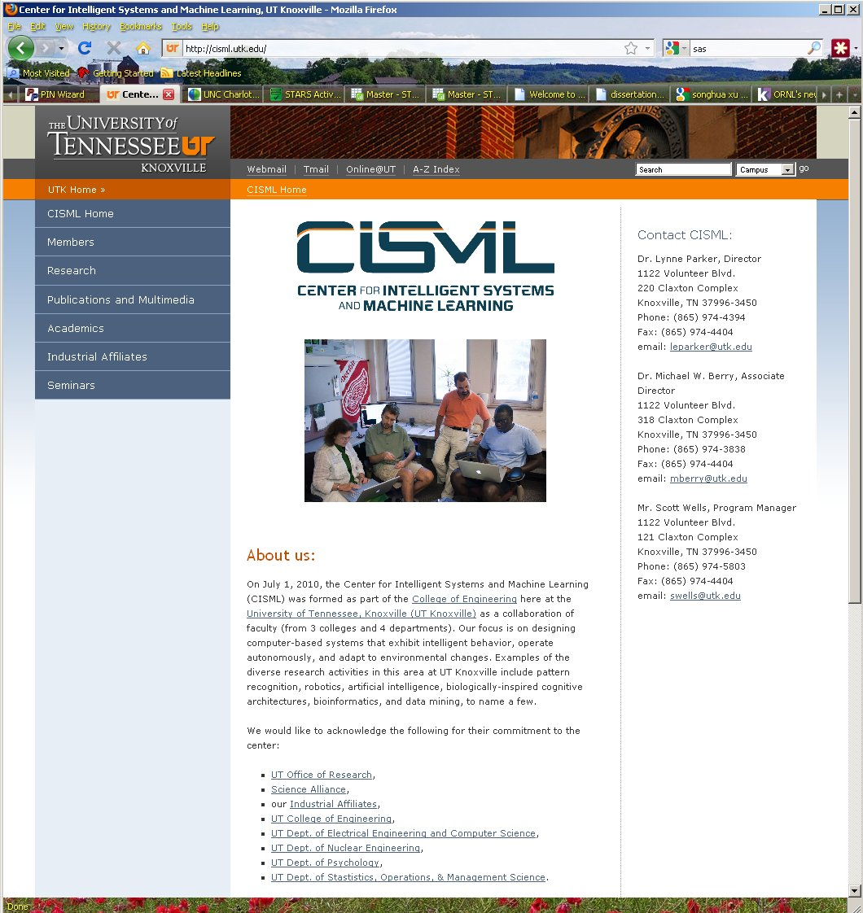
Additional Year 1 CISML Accomplishments (con’t.)
Established a web presence (http://cisml.utk.edu)
Established bi-weekly research seminar series; 9 seminars held to date
Applied for, and was approved, as an official UTK Center
Recruited 3 industrial and 6 national lab affiliates
Established a home office for CISML (Claxton 121, Moving to Min Kao EECS Building in Fall ’11)
Identified personnel to handle CISML financial and reporting requirements
Established separate cost center, enabling listing in TERA/PAMS for proposal submissions
http://cisml.utk.edu

Slide 26
New CISML Activities for FY12
Support travel for CISML faculty to visit potential research sponsors, research program planning workshops, etc.
Support seed money research funds for CISML faculty to pursue preliminary investigations
Funds will be competitive
Require identification of specific funding opportunities to be pursued, expected publication venue(s), and expected benefit to CISML
Funds will primarily support student stipends
Faculty will be required to submit developed proposals through CISML
Establish a Distinguished Seminar Series, to bring in world-recognized leaders in intelligent systems and machine learning
Speakers would also be potential research collaborators
Begin an Industrial Affiliates annual meeting
Help the Affiliates learn more about CISML
Increase awareness of potential new collaborative opportunities

Slide 27
CISML Plans and Goals for Year 2
Identification of new multi-investigator research synergies
Multi-investigator proposals
Multi-investigator publications and presentations
Interactions with potential multi-disciplinary sponsors
Initiation of Distinguished Research CISML Seminar Series
Additional Industrial Affiliate sponsors

Slide 28
Expected Returns are Significant
Increased Funding: CISML will enable UTK faculty to attract significant collaborative funding that otherwise would not be possible.
Innovative Research: CISML will develop new research directions enabled by cross-fertilization of ideas, to achieve multi-disciplinary, collaborative synergies
International Recognition: CISML will be recognized as a national and international leader in intelligent systems and machine learning
Higher Caliber Students: UTK will be better able to recruit high-caliber undergraduate and graduate students and postdocs

Slide 29
CISML Faculty -- We Welcome Collaborations!
Itamar Arel
Michael Berry
Lynne Parker
Ham Bozdogan
CISML Faculty
Daniela
Corbetta
Hairong Qi
Bruce MacLennan
Wes Hines
Jens Gregor

